Slide 1
School of Social Work and Social Policy Module Registration
Solange Daini, Dr. Kasia Wodniak
Trinity College Dublin
Trinity College Dublin, The University of Dublin

Slide 2
Module Options
A complete list of module options is available on the visiting student module directory: https://www.tcd.ie/students/orientation/visiting-exchange/module-enrolment/full-year-and-semester-1/assets/pdf/full-year-semester-1/social-work-and-social-policy.pdf
No explicit pre-requisite but suggest students avoid taking more advanced modules if they are not studying the social sciences
Visiting Students must take a minimum of 20 ECTS per term
Some modules will contain tutorials. Tutorial dates/time will be assigned after you have enrolled in your modules to fit with your timetable

Slide 3
Timetable
Module timetables are now live and can be found in your my.tcd.ie student portal
Timetables are always subject to change
All lectures will be taught on-campus
Lectures begin week 3 (9th September)
Please inform us if you have a clash with a module taught in another school
https://www.tcd.ie/calendar/academic-year-structure/academic-year-structure.pdf

Slide 4
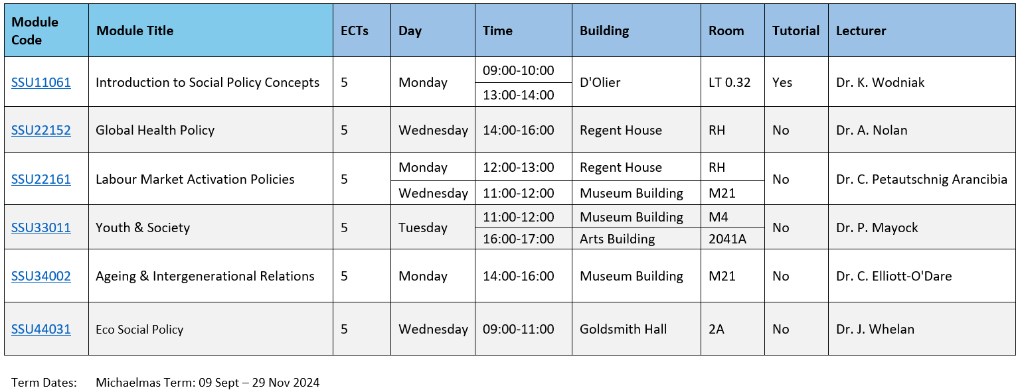

Slide 5
Important Dates
Lectures begin week 3 (9th September). Tutorials begin week 6.
Last day to add modules: September 23rd. Last day to remove modules: October 7th.
Reading Week 21st October.
Last week of teaching 24th November.
Assessment week 9th December*.
*Note: semester 1 Assessment session: 09-Dec-24 to 14-Dec-24 inclusive (contingency dates during week beginning 02-Dec-24 TBC)

Slide 6
Exam Accommodations
Exam Accommodations are managed by Trinity Disability Service.
Students should make requests as early as possible in the academic year. New requests cannot be made the week of exams. Any requests made after October may not be accommodated.
Students must first complete an Application for Reasonable Accommodations with the Disability Service.
Exam accommodations are then agreed upon during the Needs Assessment process.
https://www.tcd.ie/disability/support-and-resources/exams/exam-accommodations/

Slide 7
https://student-learning.tcd.ie/

Slide 8
Student Learning Development
Student Learning Development offers a variety of services for all Trinity College students to help them develop the skills needed to become independent learners, able to face challenges and achieve their best during their time in college. Students of all levels and abilities, even very high achievers, often need support and/or advice to achieve their best.
SLD can give that support.
https://www.tcd.ie/sld/services/

Slide 9
Contact details
Solange Daini
Global Officer
Psychology & Social Work
dainiso@tcd.ie
*Maternity Leave Cover
Dr. Kasia Wodniak
Assistant Professor
School of Social Work and Social Policy
KWODNIAK@tcd.ie
Notes:
Reminder of Contact Details

Slide 10
Thank you!
Trinity College Dublin, The University of Dublin

