Slide 1
School of Psychology Module Registration
Solange Daini, Dr. Liz Nixon
Trinity College Dublin
Trinity College Dublin, The University of Dublin

Slide 2
Module Options
A complete list of module options is available on the visiting student module directory: https://www.tcd.ie/students/orientation/visiting-exchange/module-enrolment/full-year-and-semester-1/assets/pdf/full-year-semester-1/school-of-psychology.pdf
Pre-requisite of Language module and most Sophister modules
If you have not previously studied psychology, we only offer Fresher Modules, to a maximum of 10 ECTS, for Michaelmas term 2024
Visiting Students must take a minimum of 20 ECTS per term and a maximum of 30 ECTS. Students can enrol in 30+ ECTS by special permission

Slide 3
Timetable
Module timetables are now live and can be found in your my.tcd.ie student portal
Timetables are always subject to change
All lectures will be taught on-campus
Lectures begin week 3 (9th September)
Please inform us if you have a clash with a module taught in another school
https://www.tcd.ie/calendar/academic-year-structure/academic-year-structure.pdf

Slide 4
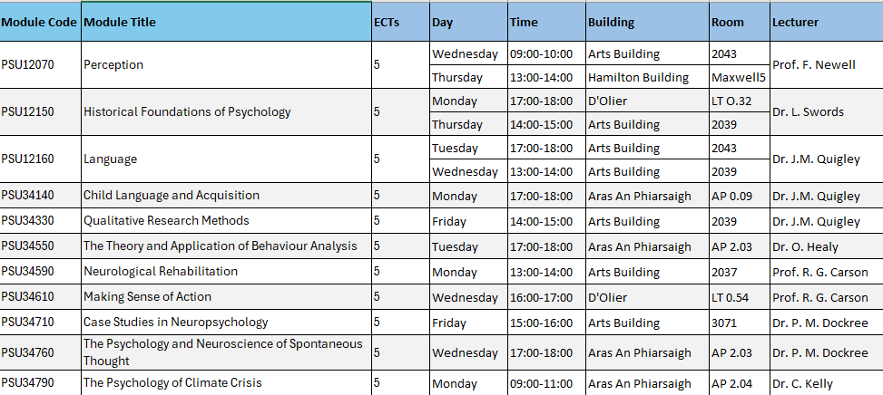

Slide 5
Waitlists
All of our modules have an initial set capacity to ensure there are no over-subscription problems (e.g.- lack of seats in lecture theatres)
We operate waitlists to ensure that popular modules have available seats and permission from lecturer before adding further students
If you have been added to a waitlist, please do not panic. Often, we can add further students, especially those that need a module for home university approval
Please email me (dainiso@tcd.ie) if you have been informed that a module is at capacity, and I will add you to the waitlist and confirm availability of additional seats

Slide 6
Important Dates
Lectures begin week 3 (9th September)
Module Enrolment: Monday 2 September at 12pm to 23 September at 5pm
Trinity Elective for full year and semester 1 visiting students takes place from Monday 9 September to Friday 13 September. Please be advised that there is no change of mind period for your Trinity Elective modules so make sure to choose carefully!
Reading Week 21st October
Last week of teaching 24th November
Assessment week 9th December*
*Note: semester 1 Assessment session: 09-Dec-24 to 14-Dec-24 inclusive (contingency dates during week beginning 02-Dec-24 TBC)

Slide 7
Exam Accommodations
Exam Accommodations are managed by Trinity Disability Service
Students should make requests as early as possible in the academic year. New requests cannot be made the week of exams. Any requests made after October may not be accommodated.
Students must first complete an Application for Reasonable Accommodations with the Disability Service.
Exam accommodations are then agreed upon during the Needs Assessment process.
https://www.tcd.ie/disability/support-and-resources/exams/exam-accommodations/

Slide 8
https://student-learning.tcd.ie/

Slide 9
Student Learning Development
Student Learning Development offers a variety of services for all Trinity College students to help them develop the skills needed to become independent learners, able to face challenges and achieve their best during their time in college. Students of all levels and abilities, even very high achievers, often need support and/or advice to achieve their best.
SLD can give that support.
https://www.tcd.ie/sld/services/

Slide 10
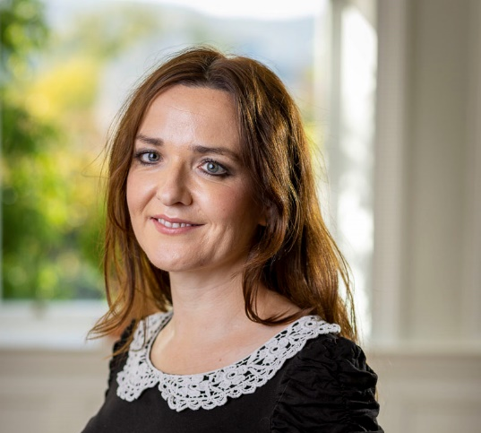
Contact details
Solange Daini
Global Officer
Psychology & Social Work
dainiso@tcd.ie
*Maternity Cover
Dr. Liz Nixon
Associate Professor
School of Psychology
enixon@tcd.ie
Room 1.22, Aras an Phiarsaigh
Notes:
Reminder of Contact Details

Slide 11
Thank you!
Trinity College Dublin, The University of Dublin

