Slide 1
Peer-Led Transition
Cultivating Belonging Through Student-Driven Programme Design and Delivery

Slide 2
Key Objectives
Strong evidence base (literature, practitioners, students)
Data system (recruitment, recognition, quality assurance)
Training resources
Session resources
Evaluation tools and measures
National framework and recommendations
Peer-Led Transition consortium
Notes:
Peer-led transition as a primary intervention for positive student menta health, and for student success

Slide 3
WP3 National Symposium (1)
Notes:
Brought practitioners from around the country together to identify their key learnings and key issues to date. Report available on 3Set website

Slide 4
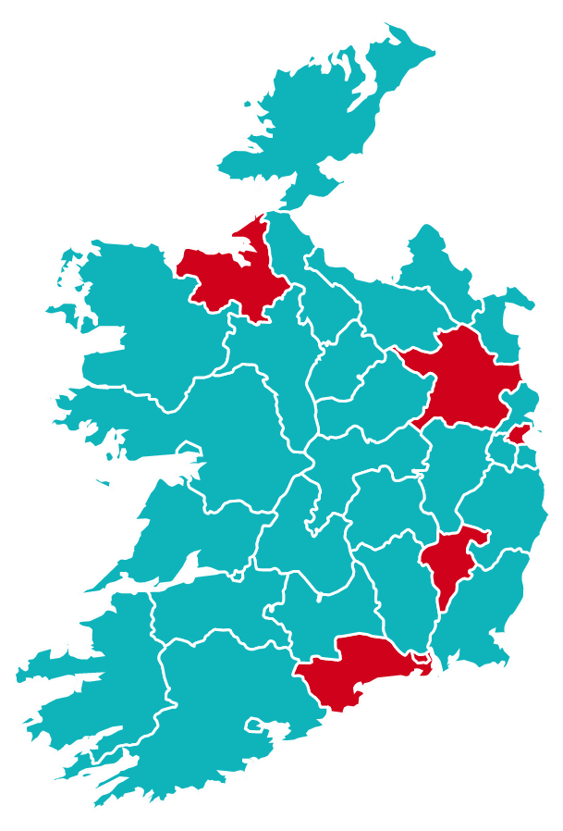
WP3 Pivot
Took model developed to date
Focused on requirements for orientation in online context
Identified national partners and enabled operation in other HEIs
?
?
?
Built and consulted with student subgroup throughout
?

Slide 5
Student Advisory Theory of Change (1)

Slide 6
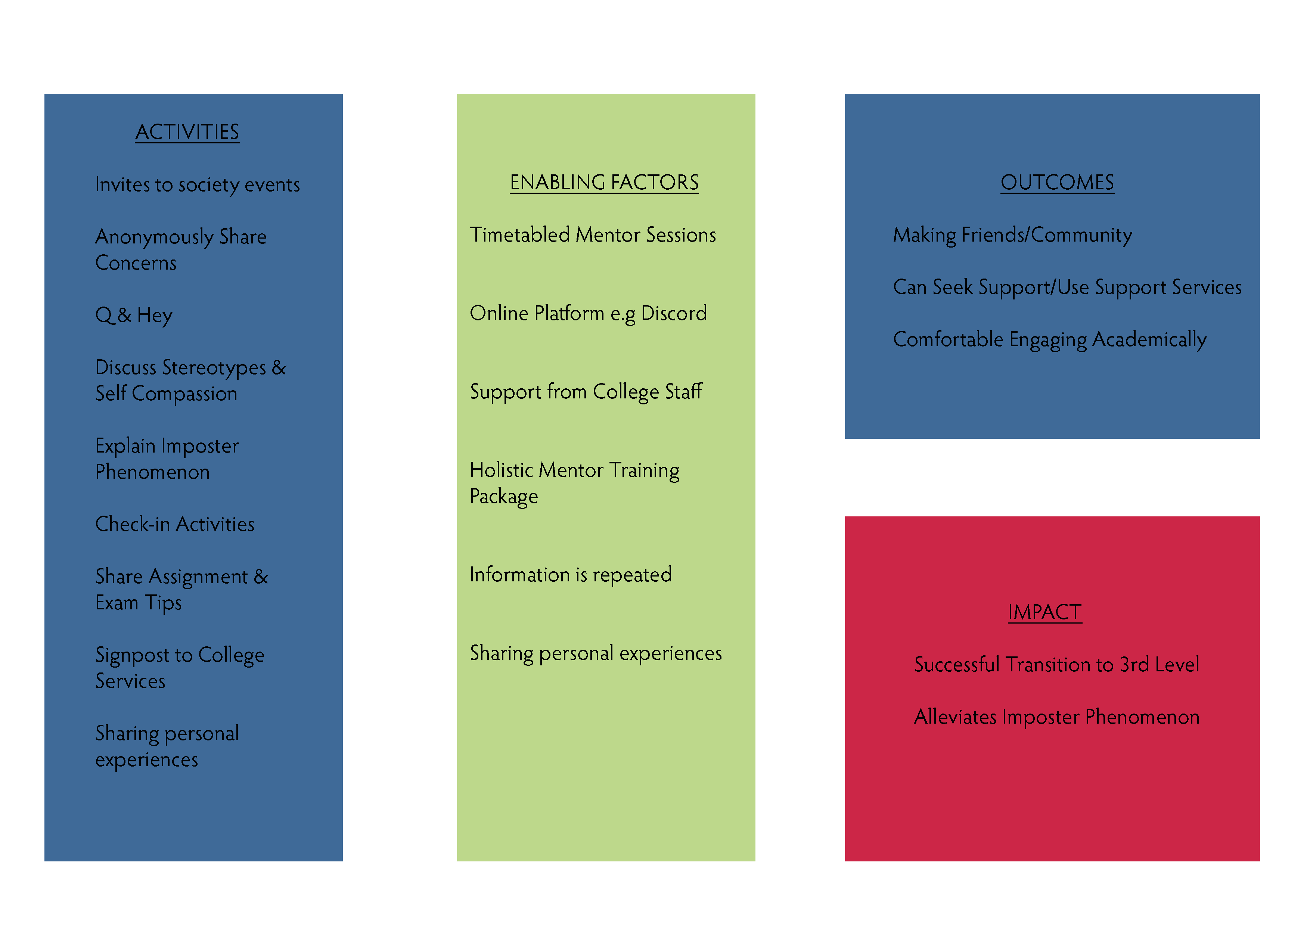
Theory of Change Model (2)

Slide 7
Pilot Model Framework
Framework to date
Notes:
In the School of Social Work and Social Policy – Course specific, timetabled sessions

Slide 8
Student Advisory Group (3)

Slide 9
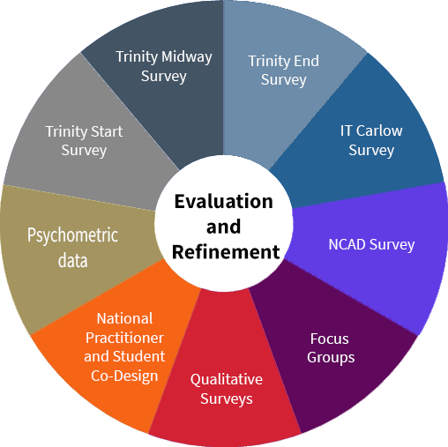
Ongoing data collection

Slide 10
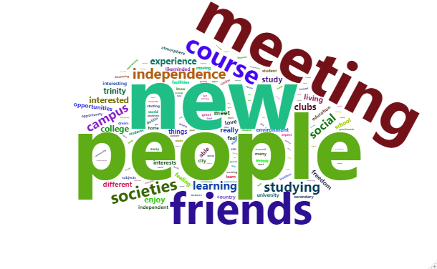
Figure 1: word cloud illustrating responses to “what has been the best thing for you about coming to Trinity?”

Slide 11
Figure 2: word cloud illustrating responses to “what has been the most challenging thing for you coming to Trinity?”

Slide 12
Figure 3: word cloud illustrating responses to “what has helped you to settle in?”

Slide 13
Figure 4: word cloud illustrating responses to “what has helped you to belong here?”

Slide 14
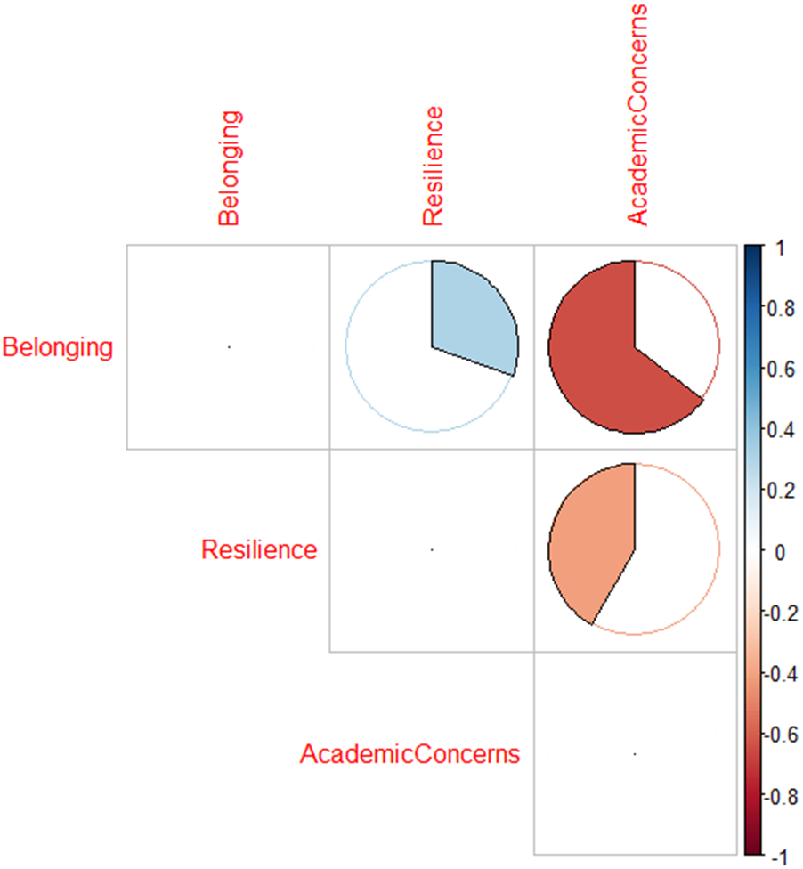
Figure 5: illustration of bivariate correlations between belonging, resilience and academic concerns, TCD, Nov 21
Belonging
Resilience
Academic
Concerns
Belonging
Resilience
Academic
Concerns

Slide 15
What predicts transitioning students’ academic concerns?
Standardised coefficients in a Multiple Regression model of academic concerns (2020/21) with belonging, resilience, gender, 1st generation status, ethnicity, sexuality, disability, and HEAR status as predictors
This model explains over 40% of the variance in transitioning students’ academic concerns. Belonging and resilience contributed significantly to the model while none of the other predictors contributed significantly to the model. Belonging was an order of magnitude greater in its predictive power compared with other factors.

Slide 16
Student Experience of the Advisory Group
• The challenge of broad student goals
• Specific student feedback
• Benefits to the students in and out of the group

Slide 17
Student Experience of the Mentor Programme
Year-long approach and COVID uncertainties
Materials encouraged participation
Zoom fatigue is real!
Decrease in engagement
Managing Mentor expectations
Witnessing connection
Using the framework to build a standard
Value of an ungraded environment
Networking skills

