Slide 1
Redesigning Peer-led Transition
3Set Work Package 3

Slide 2
Retention & Engagement Strategy

Slide 3
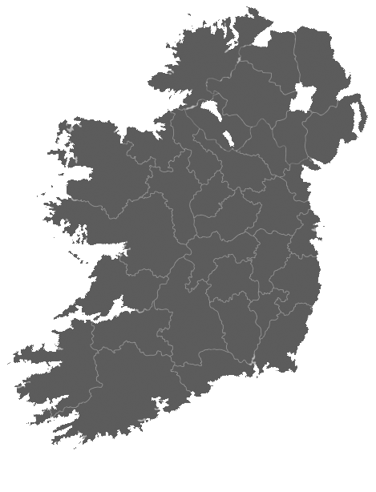
Work Package 3 Model
Based on international research
Adjustable, replicable
model
Building on the S2S opt-out model and SLD materials
Informed by best practice and identified needs nationally

Slide 4
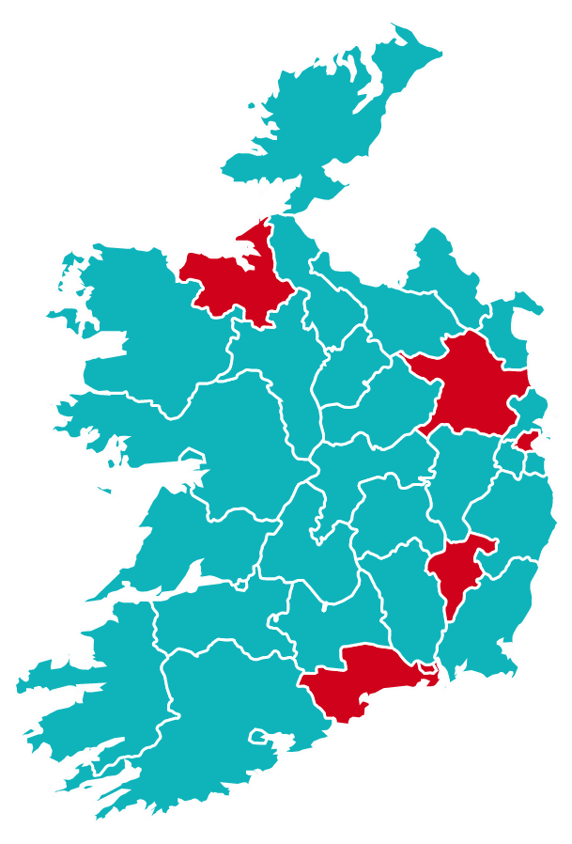
Work Package 3 Pivot
Took model developed to date
Focused on requirements for orientation in online context
Identified national partners and enabled operation in other HEIs
?
?
?
Built and consulted with student subgroup throughout
?

Slide 5
Q & Hey

Slide 6
Q & Hey

Slide 7
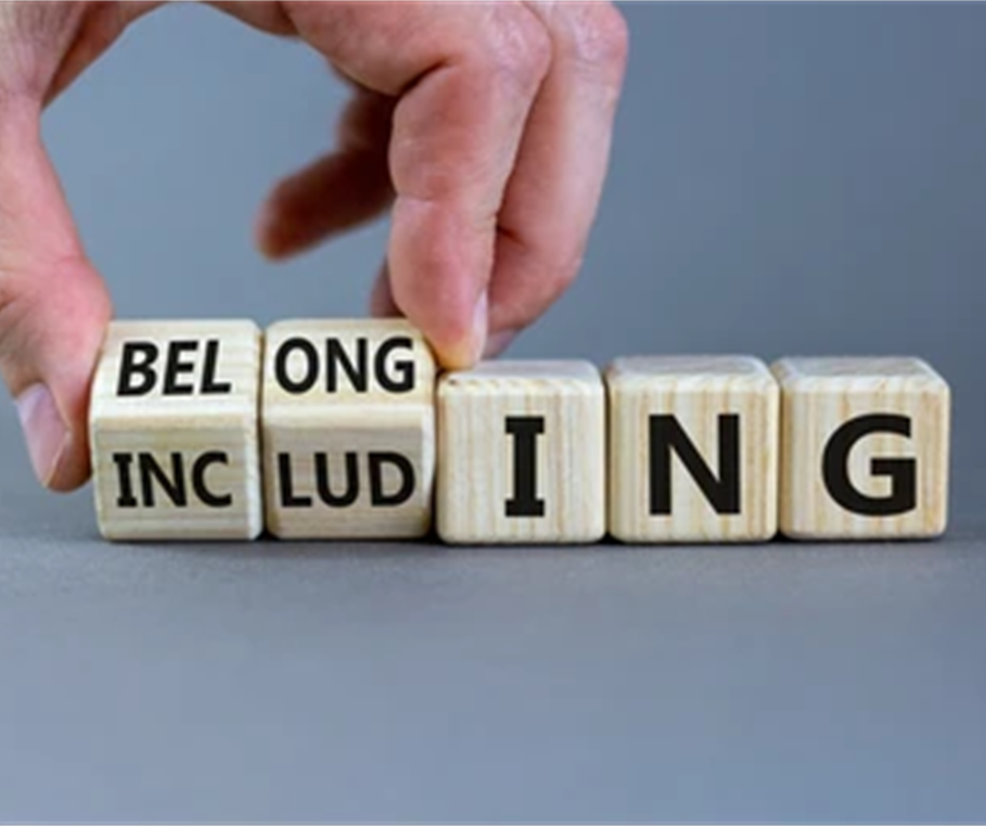
Student Voice
https://www.tcd.ie/Student_Counselling/3set/studentvoice/index.php

Slide 8
Evaluation model
Evaluating pilot and pivot models using repeated surveys
Survey includes measures of all key aspects of the theory of change model including:
Retention concerns – CIAO (BACP, 2012)
Academic concerns – CIAO (BACP, 2012)
Student experience concerns – CIAO (BACP, 2012)
Long-term concerns – CIAO (BACP, 2012)
Demographics
Meehan and Howell’s (2018) qualitative undergraduate transition questionnaire
Resilience Measure: Brief Resilience Scale (Smith, Dalen et. al., 2008)
Measures of belonging:
Psychological Sense of School Membership scale (PSSM) (Positive Youth Outcome Measure 5)
A single item belonging scale (Gopalan and Brady, 2019)

Slide 9
Evaluation model
If the model works, we expect to see a strong association between resilience and belonging, and indicators of student success (emotional, social, academic)
If the intervention is successful, we expect to see improvements in resilience and belonging between surveys with an associated reduction in intentions to withdraw from course etc.
Using existing measures:
benefits for validity and reliability
comparable with other research
aids reproducibility
Psychometrics allow testing of the theory of change model
Qualitative data allows induction of new insight into the model and may help explain ‘why’ and ‘how’
If the model is successful in Trinity, the results will need to be replicated in other HEIs to prove the model’s efficacy

Slide 10
Open Research
We follow open research principles and are eager to share our materials, methods, data analysis etc. to encourage replication. Search 3SET on osf.io (Open Science Framework website) and contact us so we can share any challenges we came across etc.
The more we share across settings the healthier the field of higher ed research becomes and the more confident we become about what works
Cross-comparison of findings using the same methodology in different settings yields its own insights

Slide 11
Initial findings
 | “I feel that I am part of Trinity College” (strongly disagree – strongly agree) | “To what extent are you questioning whether you might leave your course?” | “To what extent are you concerned about your capacity to study?” | “Do you have worries about your student experience?” | “How often would you say you feel positive about the future as a student in 3rd level?” | Brief Resilience Scale | Psychological Sense of School Membership scale
“I feel that I am part of Trinity College” (strongly disagree – strongly agree) |  | -0.31^ | -0.26^ | -0.44^ | 0.45^ | 0.19^ | 0.56^
“To what extent are you questioning whether you might leave your course?” |  |  | 0.30^ | 0.21^ | -0.44^ | -0.24^ | -0.42^
“To what extent are you concerned about your capacity to study?” | -0.26^ | 0.3^ |  | 0.33^ | -0.37^ | -0.33^ | -0.33^
“Do you have worries about your student experience?” | -0.44^ | 0.21^ | 0.33^ |  | -0.40^ | -0.21^ | -0.38^
“How often would you say you feel positive about the future as a student in 3rd level?” | 0.45^ | -0.44^ | -0.37^ | -0.40^ |  | 0.35^ | 0.55^
Brief Resilience Scale | 0.19^ | -0.24^ | -0.33^ | -0.21^ | 0.35^ |  | 0.35^

Slide 12
Initial findings
Strong associations between key variables supports the theory of change
Demographics are poor predictors of belonging (surprising?)
1st generation (lower cultural capital) students have higher belonging and resilience indicating possible ‘survivor effect’ – implications for pre-admissions policies?
Roughly half of students registered with the disability service did not avail of the disability access route – pre-admission issue?

Slide 13
Initial findings
Qualitative insights include:
high prevalence of imposter feelings including not feeling good enough for course
pandemic isolation
inability to meet others is a major factor - students who have met others report this as one of the best things while those who haven’t report as worst
very positive feelings about academics as well as some issues with difficulty – students enjoy being challenged and focusing on a subject they have passion for

Slide 14
Next steps
Evaluate coronavirus pivot using survey data and learn from/despite of the exceptional circumstances - challenging to separate pandemic effects from usual transition (some initial findings shown) – lots of insight about hybrid learning
Trial the pilot model in one school allowing comparison between pilot and existing models - is the pilot better?
Ask students directly for their feedback with additional focus groups to supplement surveys – opportunity for improvements and novel insights
Collaboration with other HEIs, and crucially REPLICATION

Slide 15
Theory of Change Model
We completed a theory of change model with students from HEIs nationally.
This drove the development of our pilot plan, training programme, and support structure.

Slide 16
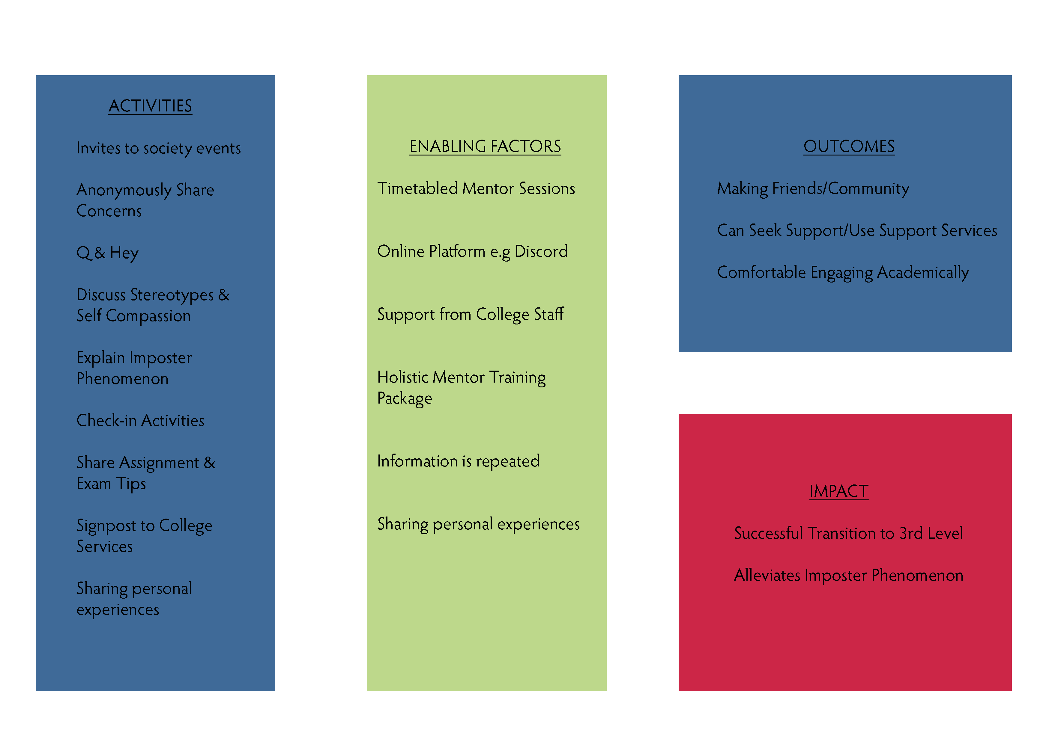
Theory of Change Model

Slide 17
In Breakout Rooms Discuss
Change Mechanisms
The feeling between the activities and the outcomes.
What is driving the development of the volunteers and the 1st years.

Slide 18
Your thoughts

Slide 19
Open Access Resources (Creative Commons License)
Building on it together

