Slide 1
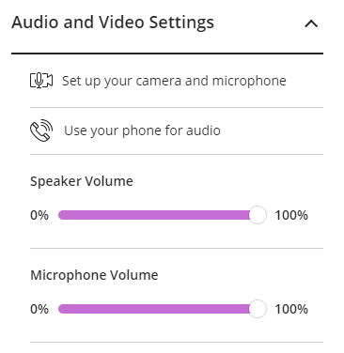
The session will begin shortly
While you’re waiting, here’s an overview of the webinar software
Webinar Options
At the bottom of the screen, you can see 4 more icons:
Sending a Message
Click on the pink Collaborate button (bottom right) to open the chat window and enter a message.
Set your status
Raise your hand
Closing the Collaborate panel
To close the Collaborate panel at any time, click on the X on the bottom right hand side.
Turn mic on and off
Turn camera on and off
Leaving the Session
Click the menu icon at the top left and then ‘Leave Session’. A recording of the webinar will be made available afterwards.
Check Your Audio
To check your audio setup, go to > My Settings - > Audio and Video Settings -> Set up Your Camera and Microphone.
Chat Window Options
Icons can be selected at the bottom of the chat window:
Chat
My Settings
To check your computer’s volume setting, go to My Settings - > Audio and Video Settings.
Here you can increase your speaker and microphone volume
Participants
Share Content

Slide 2
Academic Integrity and the Art of Referencing Postgraduate Summer School 2024 library@tcd.ie|www.tcd.ie/library|@tcdlibrary

Slide 3
Overview
To recognise what good academic practice looks like
To learn about practices that help you avoid academic misconduct
To understand why citing and referencing is necessary
To practice applying citation rules

Slide 4
Trinity's Statement on Academic Integrity
At Trinity College Dublin, we commit ourselves as staff and students to acting responsibly and ethically, embracing integrity in all our actions and interactions as members of the College community.
Understanding that integrity requires honesty, transparency and accountability, we agree to:

Slide 5
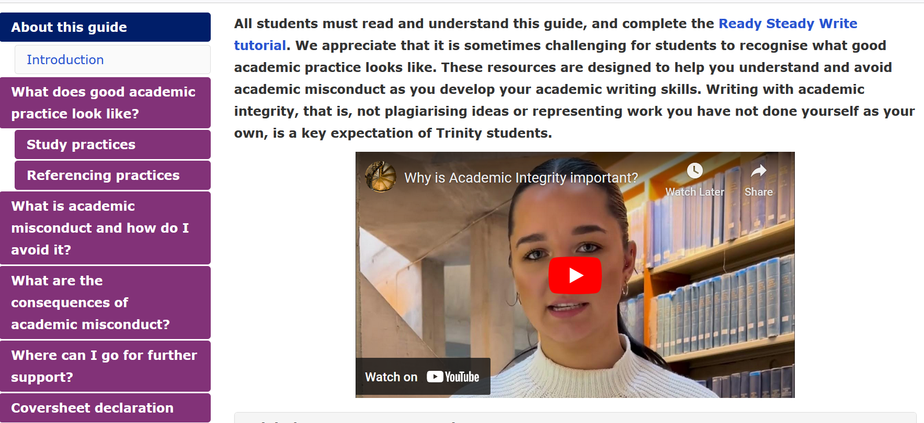
Academic Integrity Library Guide
Make sure to check out the
Academic Integrity Library Guide

Slide 6
Trinity's Statement on Academic Integrity
Strive to do what we say we will, ensuring that we are aware of our commitments and responsibilities in order to fulfil them, and abiding by College and other relevant policies and the highest standards of conduct.
Give credit where credit is due, recognizing and acknowledging the contributions and achievements of others in scholarship, teaching, research and service.
Tell the truth, as a community and as individuals, speaking out and listening even when it is difficult, naming problems and honestly acknowledging mistakes.
Hold ourselves and others to account for the things for which we are each responsible.
Use resources for the purposes for which they are intended and be above reproach in financial dealings.
Deal fairly, consistently and transparently with others.

Slide 7
What does good academic practice look like?
Being organised, managing your time well and developing a note-taking strategy that works for you, are essential components of academic integrity.
Knowing when to cite sources and adhering to referencing guidelines, promote responsible scholarship and contribute to the credibility and reliability of your academic work.

Slide 8
What does good academic practice look like?
Getting organised
Good organisation of all your readings or sources of information will help you to find your sources easily and quickly.
Set up folders and use reference management software
Time management
Don’t leave assignments until the last minute!
Note-taking
Put your reference at the top of the page. That way you will always have the references when you need them
Citing and referencing
More on this to follow

Slide 9
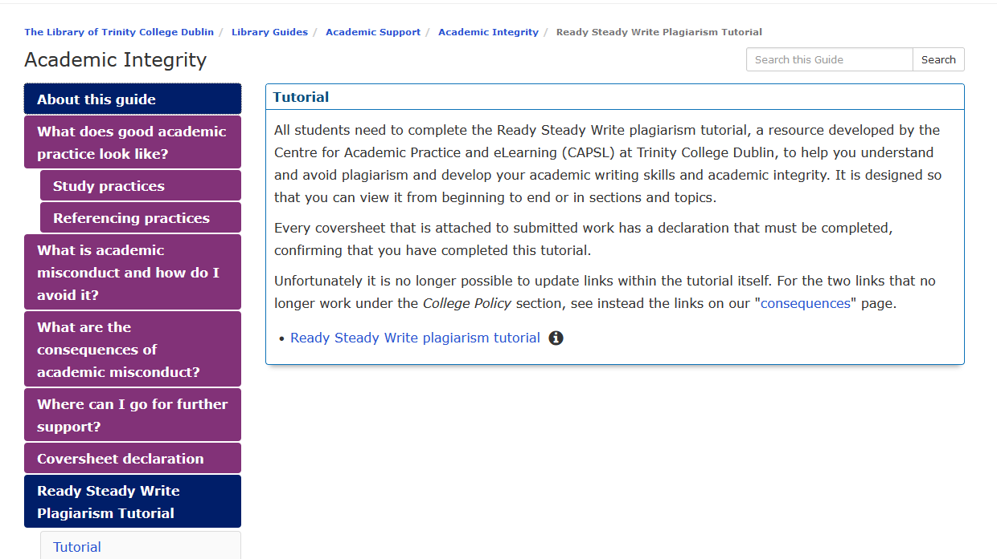
Ready, Steady, Write tutorial (to be updated)
Notes:
Provide URL - All students are required to complete this tutorial.

Slide 10
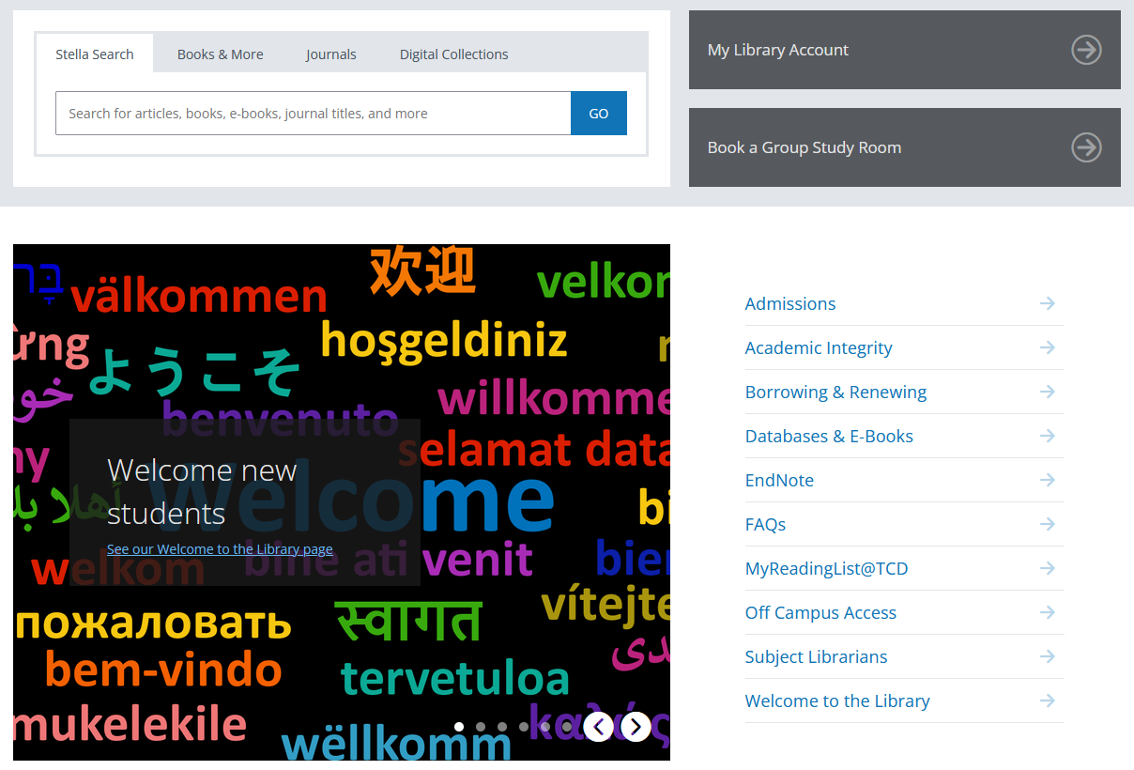
Academic Integrity – Library website
Notes:
Provide URL

Slide 11
A helpful video
Source: http://youtu.be/2q0NlWcTq1Y, Bainbridge State College

Slide 12
What is Academic Misconduct?
Academic misconduct covers all behaviours which contravene academic integrity
Plagiarism
Self-plagiarism
Collusion
Falsification/fabrication
Exam cheating
Fraud/impersonation
Contract cheating (e.g. essay mills)
Writing Center, University of North Carolina at Chapel Hill
Academic Integrity Lib guide TCD

Slide 13
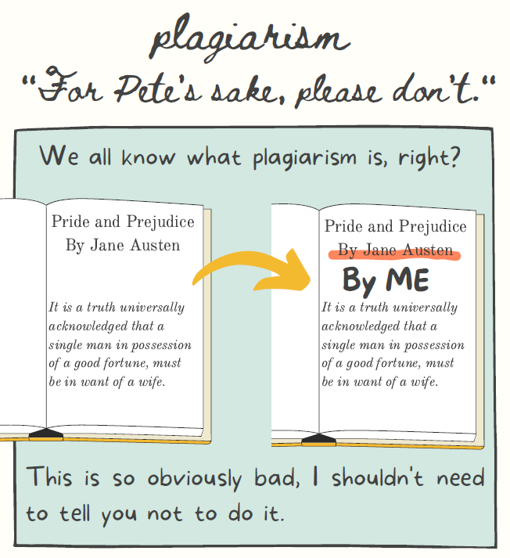
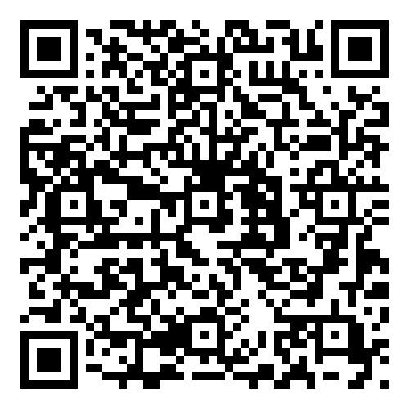
Plagiarism example
A quick guide
by Emily Myers from the University of Connecticut

Slide 14
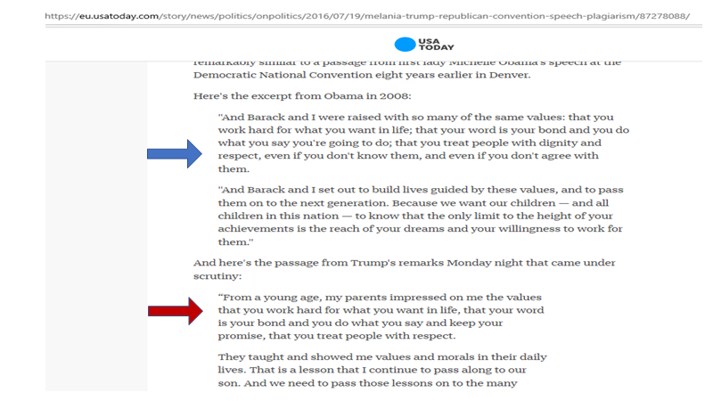
Melania Trump vs. Michelle Obama speeches

Slide 15
the consequences of Academic Misconduct
Penalties for Plagiarism
Detected plagiarism can carry severe consequences
It is the act of plagiarism that is punished, regardless as to whether you meant to plagiarise or not
You must complete the College’s “Ready Steady Write” plagiarism tutorial (available on the Library’s Academic Integrity website) and sign a declaration when submitting course work, whether in hard or soft copy or via Blackboard, confirming that you understand what plagiarism is and have completed the tutorial

Slide 16
The Impact of Academic Misconduct
A note on the ethical implications: why is Academic misconduct harmful?
De valuing body of academic work
The unreliability of a source
Spreads misinformation
Responsibility as a writer/publisher to create honest original research
Article: finding the truth in science

Slide 17
Avoiding Plagiarism
Now that we know what plagiarism is, how do we avoid it?
Citing and Referencing!
Citing and referencing correctly allows readers of your work to find the original sources
Show you have adequately represented other’s ideas
Shows you are not trying to claim those ideas as your own.
Photo: mejnak www.istockphoto.com

Slide 18
What is the point of acknowledging sources through citations?
“If I have seen further it is by standing on ye shoulders of Giants” (Newton, 1676)
Papers on the same subjects will use similar terminology, and draw on the ideas and research that has gone before. This is an expected and necessary part of research
However, it is also expected that you credit your sources by citing them
This allows readers of your work to find the original sources and see if you have adequately represented their ideas, and shows you are not trying to claim those ideas as your own
Notes:
Seán takes over at this point

Slide 19
In text Citations
Direct quotations
Paraphrasing
Quoting an online article from a journal (example)
Quoting a chapter from a book (example)

Slide 20
Citation Styles
Many different citation styles are used in Trinity.
Your lecturer, course director or supervisor will advise if you should use a particular citation style.
Here we will look at two styles detail
APA 7 – A parenthetical citation style
Chicago 17 Footnote or notes and bibliography style

Slide 21
Our Example
Reference Type: Journal Article
Author: McClimens, Alex; Kenyon, Lynn; and Cheung, Heidi
Year: 2013
Title: Exploring placement pathways in nurse education
Journal: British Journal of Nursing
Volume: 22
Issue: 1
Pages: 8-15
DOI: 10.12968/bjon.2013.22.1.8

Slide 22
parenthetical citation style
APA 7th Edition
Handbook: available in the Library

Slide 23
ParentheticalStyle
Parenthetical styles are sometimes called the “Harvard” style as they were first used at Harvard in the 1880s
They are called Parenthetical styles as they enclose the partial information in brackets ( )
They are also sometimes called Inline styles
Most use author and date and so those styles are often referred to as Author-Date styles
*Not all use author-date, e.g, MLA uses author and page number

Slide 24
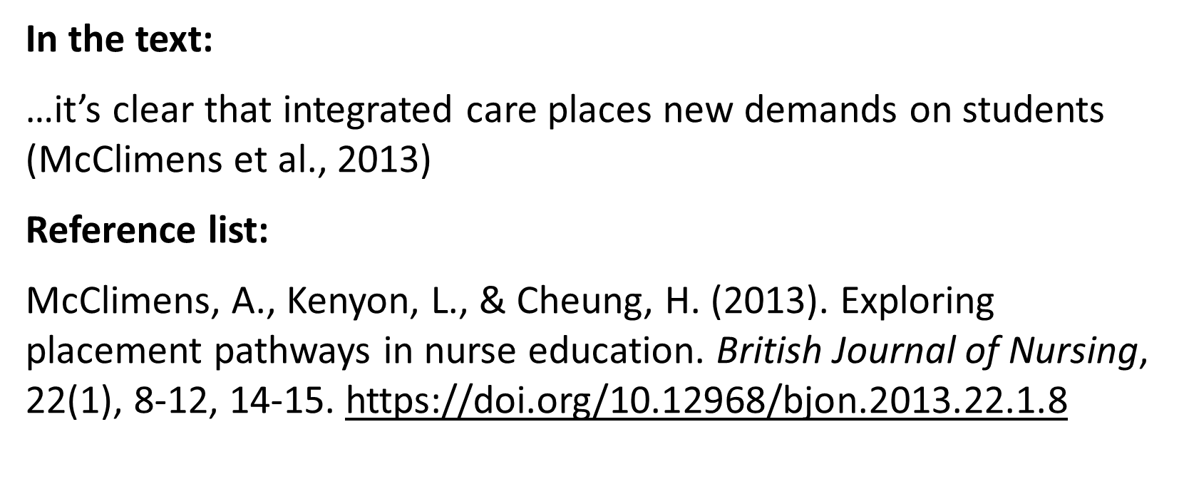
APA 7 example

Slide 25
Chicago notes and Bibliography Style
The Chicago Manual of Style is available for free online

Slide 26
Footnote style – Chicago Footnote 17th ed.
In the text:
…it’s clear that integrated care places new demands on students¹
As a footnote at the bottom of the page:
¹ Alex McClimens, Lynn Kenyon, and Heidi Cheung, "Exploring Placement Pathways in Nurse Education," British Journal of Nursing 22, no. 1 (2013), https://doi.org/10.12968/bjon.2013.22.1.8.
(elements are separated by commas)
In the reference list, which is in alphabetical order:
McClimens, Alex, Lynn Kenyon, and Heidi Cheung. "Exploring Placement Pathways in Nurse Education." British Journal of Nursing 22, no. 1 (2013): 8-15. https://doi.org/10.12968/bjon.2013.22.1.8.
(first author’s name inverted, elements are separated by full stops)

Slide 27
Footnote or Notes and Bibliography styles
Like numbered styles, footnoting styles give the reference an ascending number in the text and the full references are listed in that order at the bottom of the page in a footnote. A full list at the end of the work or chapter may also be required - although unlike with numbered styles, this will be in alphabetical order by surname, rather than in order of mention
The Chicago 17th Edition “Notes and Bibliography” style is the latest version of the best-known footnoting style
Another (used by the School of History here) is the Irish Historical Studies style
Notes:
Could we simplify slightly? And possibly omit reference to IHS?

Slide 28
Numbered style – Vancouver
In the text:
…it’s clear that integrated care places new demands on students (1).
Reference list:
1. McClimens A, Kenyon L, Cheung H. Exploring placement pathways in nurse education. British Journal of Nursing. 2013;22(1):8-15.
Numbers are reused for the same reference!

Slide 29
Numbered styles
Numbered styles list references in the order they are mentioned, using a digit in the text to refer to the fuller citation at the end
The most common numbered style is Vancouver - while this style has its own particular rules, numbered styles in general are often referred to as Vancouver styles
Other common styles used are IEEE, JAMA, and the Lancet

Slide 30
Maintaining accurate records
It is vital to maintain accurate records of your sources, in order to be able to properly attribute the phrasing and ideas you draw from them
There are different approaches to keeping accurate records, e.g., you might keep full handwritten or word-processed notes detailing each reference
Another way would be to save particular searches or records (e.g., by marking those records) in individual databases, e.g., JSTOR or PubMed
Stella will allow you to mark records in a similar way and save or e-mail the results to your computer

Slide 31
reference management software
The easiest way to bring together references from all sources is to use bibliographic reference managing software. Some of the apps with free versions include Zotero, EndNote Basic and Mendeley. Trinity has a subscription to a more powerful version of EndNote than the free app.
These apps allow you to import records from multiple databases, library catalogues and to also manually enter citations, and save them as a database in one location. They can then put the citations into your document, in a reference style you specify.
The Library runs classes on using EndNote throughout the year. We support two versions - EndNote Online and EndNote Desktop.

Slide 32
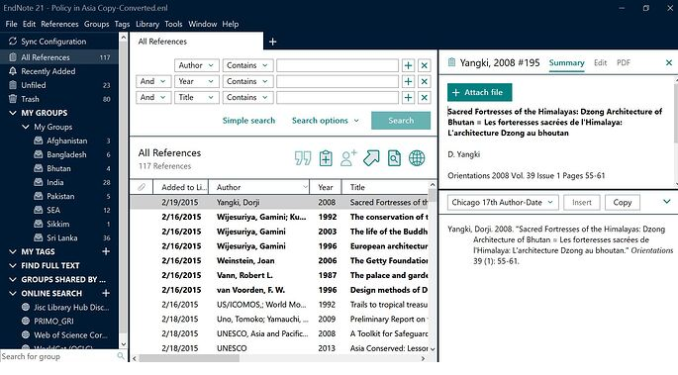
Reference Management
What is Endnote?
Library Endnote tutorial
Other referencing management tools:
Zotero
Mendeley
https://community.endnote.com/t/endnote-21-reference-panel-wont-adjust-bring-back-change-layout/712967

Slide 33
Reference management tools
Commonly used tools include: Zotero, EndNote Online, EndNote Desktop and Mendeley
EndNote Online is free for all members of Trinity to use. It is cloud-based, with a small plugin to install on your computer that enables it to be used with Microsoft Word
EndNote Desktop is an app installed on a particular computer – it is also free for all members of Trinity to use and can be downloaded from the Library website. Many researchers find it more powerful than EndNote Online but some use EndNote Desktop and EndNote Online together
The Library provides support for both EndNote Desktop and EndNote Online

Slide 34
Coversheet required for each piece of submitted work

Slide 35
Turnitin
Lecturers and examiners will be familiar with key sources and will notice when information has been used from them, as well as differences in style, terminology and accuracy in an essay
In addition, the vast majority of courses in Trinity use Turnitin to check written submissions for plagiarism. This compares submitted work to a database of websites, articles, books and student papers

Slide 36
Turnitin - similarity score
The “similarity score” is not a measure of plagiarism!
You may have a high similarity score but that might be satisfactory as long as you have made sure to cite all your references
You may have a low score but you could have been heavily paraphrasing other sources without citation

Slide 37
Turnitin – Help
For help on how to use Turnitin, see advice from The Centre of Academic Practice, using their guide;
Technologies for Digital Learning
Notes:
Students should not use the Turnitin website for help as it is quite confusing for users to navigate and often gives them wrong info (e.g. they might end up looking at the advice for Turnitin.com not the Blackboard version). Also if they have issues with submitting their similarity report etc. they should contact their instructor in the first instance for help.

Slide 38
Concerns around…
Paraphrasing
Copying and Pasting
Quoting
Common knowledge

Slide 39
Paraphrasing
There is nothing wrong with including short paraphrases of others’ work (it demonstrates processing/synthesis) but you must attribute the ideas to them
Think carefully though if you decide to use a long segment of paraphrasing as you are likely to lose marks on stylistic grounds, but note this is not plagiarism as long as you have proper citations – just poor writing/style!

Slide 40
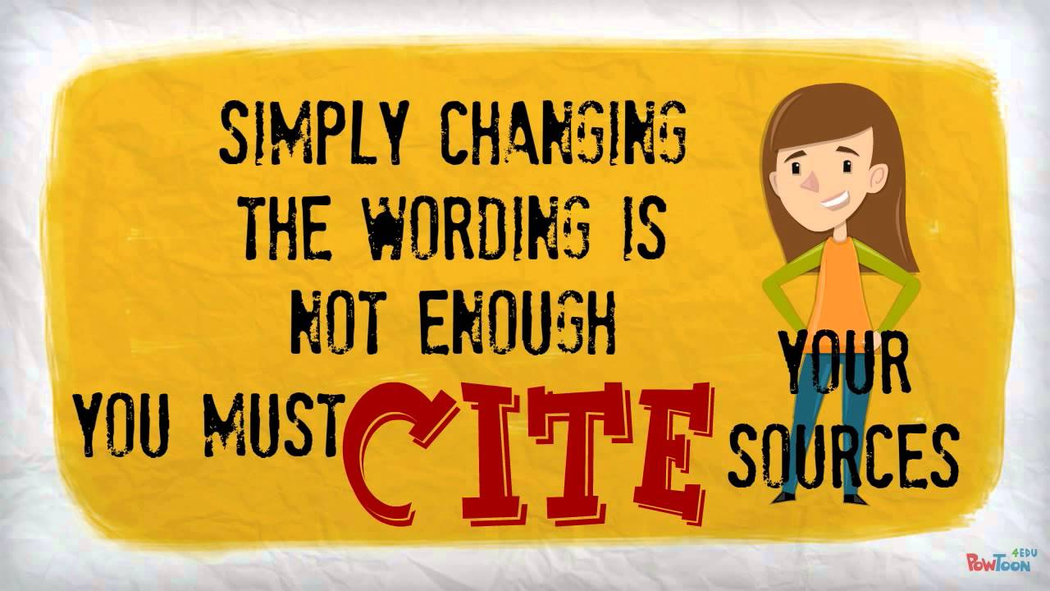
Copy, shake and paste
“Copy and paste” is *very* easy to detect, but so is “Copy, shake and paste” – mixing up paragraph order, changing words etc. to make lifted sections appear different
Source: https://www.youtube.com/watch?v=LRODESfNzcc

Slide 41
Using quotes
You will be given guidance by your department on how exactly to use quotations in your work. Any direct quotes (i.e., in a sentence) of another’s words must be put into quotation marks and attributed
Block quotes (longer quotes as a separate paragraph) should generally be used sparingly, as overuse will demonstrate you have little original material of your own to add!

Slide 42
Common knowledge? If in doubt, CITE!
Common knowledge depends on the discipline
In all academic or professional fields, experts regard some ideas as common knowledge
This is generally defined as facts, dates, events and information that are expected to be known by someone studying or working in a particular field

Slide 43
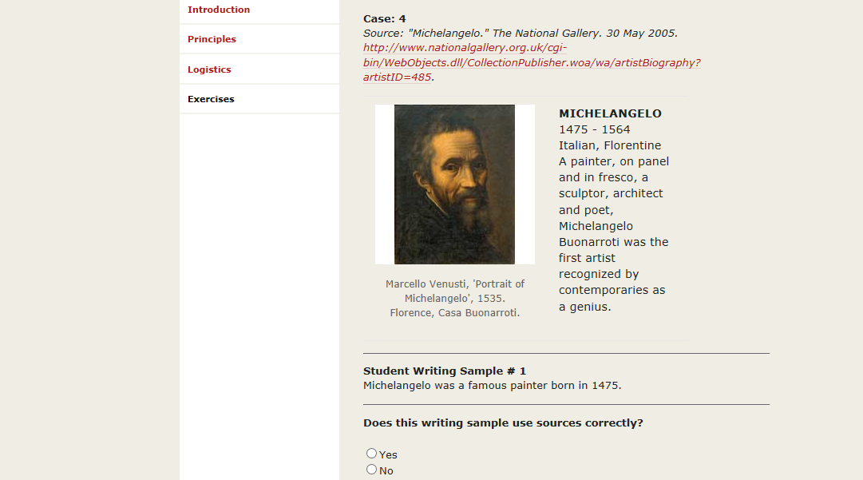
A useful open access online tool: Cornell tutorial
Cornell University, College of Arts and Sciences:
https://plagiarism.arts.cornell.edu/tutorial/exercises.cfm

Slide 44
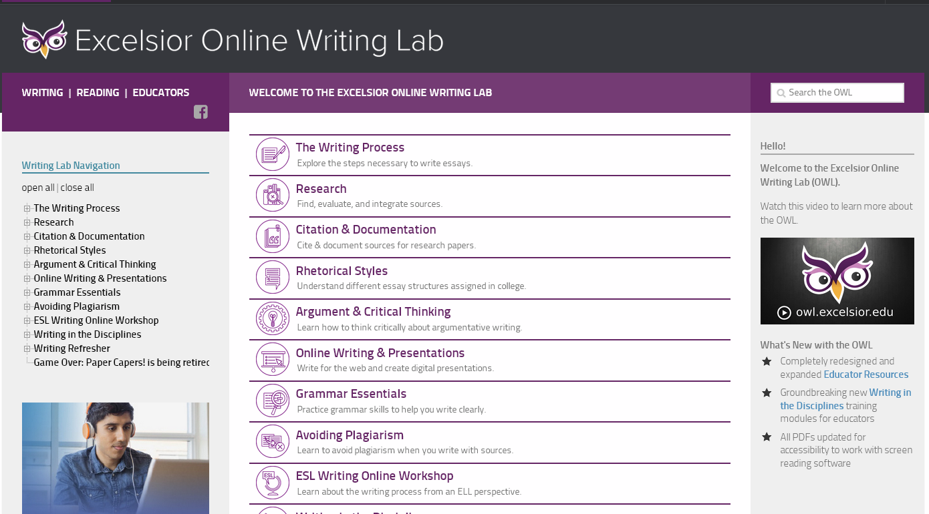
Excelsior Online Writing Lab: A great resource for style guides
https://owl.excelsior.edu/
Notes:
Provide URL

Slide 45
But I need more info about…
General Academic Integrity questions -
start at https://libguides.tcd.ie/academic-integrity and complete the tutorial
e-mail your Subject Librarian
General referencing questions –
try Excelsior Online Writing Lab – a great resource for style guides
e-mail your Subject Librarian
Turnitin – talk to your supervisor, course director or school/departmental administrator first
Which referencing style to use – talk to your supervisor, course director or school/departmental administrator
EndNote – us again (Library Subject Librarian team)
Academic writing in general – Student Learning Development
Notes:
Simplify and update? Eg no duty desk???

