Slide 1
Equality, Diversity and Inclusion
School of Psychology October 2023

Slide 2
What is EDI?
“We are committed to creating an inclusive, diverse, and pluralist College community and a positive environment in which all can participate, and all are recognised fully for their contributions. We are committed on all equality grounds to protecting staff and students from discrimination and to ensuring that diversity is promoted and celebrated.”

Slide 3
Who are we?
Working group | Lead | Members
Culture | Adele Grazi | Hana Tuite, Meg Ryan
Staff Recruitment, Development, and Progression | Redmond O’Connell | Ruth Byrne, Barbara Hannigan, Sonia Bishop, Lorraine Ivers
Student Recruitment and Support | Lorraine Swords | Fiona Newell, Erin Paullin, Gabriel Byczynski, Alina Cosma
Governance, Policies, and Data | Clare Kelly & Kristin Hadfield | Aleksandra Hamny, Elena Dell’Utri, David Hevey
Communications and Marketing | Michael Gormley | Erin Paullin, Shane O’Mara

Slide 4
A little history
Trinity receives Bronze award 2015
Athena Swan application – April 2020
Charlotte stepped down as Director in 2022
Kristin takes over as Director in April 2022
Trinity receives Silver Athena Swan in July 2023

Slide 5
What are our goals?
Goals were created by the School → part of the Athena Swan activities ahead of the 2020 submission
+ new goals as things come up
Athena Swan Action Plan
~60 actions

Slide 6
What have we accomplished?
Annual survey of staff and students on EDI issues
Data collection on progression differences to PG courses by gender
Obtain data on training uptake by staff
Mentoring of academic staff within the School
Promotions workshop and resource sharing

Slide 7
What have we accomplished?
Alumni career information gathered and analysed
One-to-one HoS meetings
Meeting with HoS after extended leave
Formal school-level induction for new staff
More social events

Slide 8
What do we still have to accomplish?
Quite a bit!
Some challenges:
Accessing data
Sharing data (GDPR)
Shifting priorities
Everyone is busy
College Regulations

Slide 9
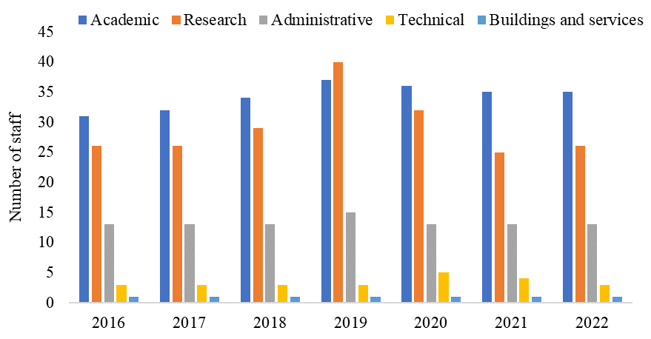

Slide 10
Survey on One-to-One Head of School Meetings
Notes:
21 respondents (2/3rds or so of faculty)
11 male, 8 female, 2 prefer not to say

Slide 11
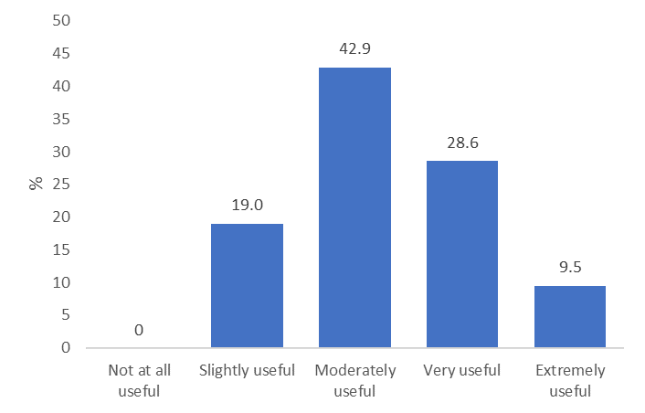
How useful was your 1:1 meeting with Sven?

Slide 12
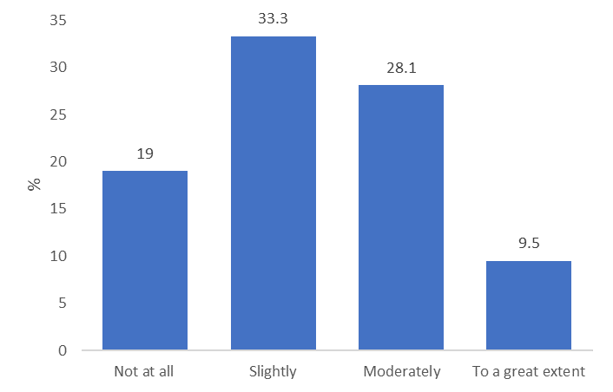
To what extent did this meeting help you to address challenges you’ve been facing in terms of your career?

Slide 13
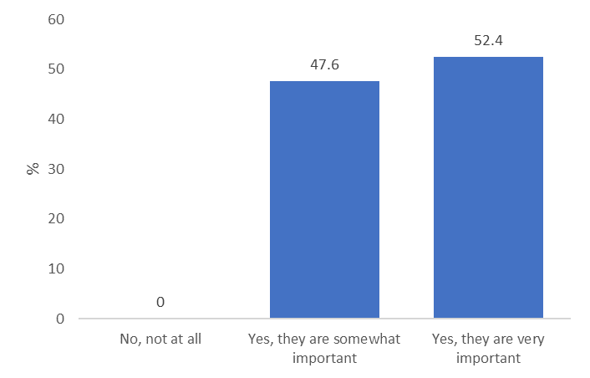
Regular 1:1 meetings with the Head of School are an important part of staff development.

Slide 14
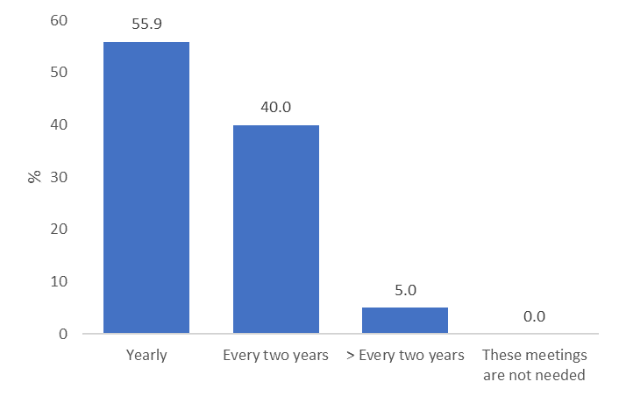
How often should these 1:1 meetings be held?

Slide 15
Written feedback - Changes
The form
Takes too long to complete / waste of time
Does not seem to be connected to the focus or content of the meeting
Export RSS (and add a bit?)
Could be changed to align with the promotions application, for those applying for promotion
Should have a single online system in which staff can indicate their workload, including teaching, admin etc
Outcomes
Want concrete outcomes from the meeting

Slide 16
Written feedback - Changes
“I spent a very long time filling out the form but felt that it didn't add to the content of the meeting. It wasn't examined once during the meeting so the detail that was important to me, wasn't discussed.”
“It feels like another admin task to prepare the dossier - wasteful of time. would be much more streamlined if we could just export the RSS CV or something”
“More specific feedback and responses to issues raised. The form was too long and not focused sufficiently.”
“Would like to see evidence for concrete action/outcome of these meetings. How, for example, might our respective teaching contributions be more equitably distributed?”

Slide 17
Written feedback – Good parts
Support
Felt heard, supported, and understood
Opportunity
Rare opportunity to interact with HoS
Chance to raise issues that are uncomfortable to raise elsewhere
Express concerns
Reflection
Timing
Nice to have them altogether within 2 weeks
30 minutes is a good length
Updates
To hear about updates on the School structure
HoS
Open, friendly, took it seriously

Slide 18
Written feedback – Good parts
“It was good opportunity to reflect on role and nice to chat in person.”
“It was the first time I had had such a conversation with a HoS in years.”
“Great to have dedicated time with HoS and discuss research interests, workload and to have the opportunity to present the scope/demands of work involved. Feel there was an understanding of particular challenges faced in different research areas.”
“Feeling utterly heard and supported by Sven, his approach, and having an opportunity to reflect, request and hopefully implement supports to achieve my goals.”
“It's a great opportunity to interact with the Head of School and to let them know your concerns. I imagine that it also helps the Head of School a lot in hearing from people who maybe don't feel comfortable or don't want to speak up in the full School meetings.”

Slide 19
Survey from former students on careers
Notes:
Data from 183 previous students that graduated in the years 2017 to 2021 regarding their current sector of employment was analyzed. 79% of the respondents were identified as female, the remaining 21% were male. Most data were obtained from postgraduates (n = 146, 120 female) compared to undergraduates (n = 37, 25 female).

Slide 20
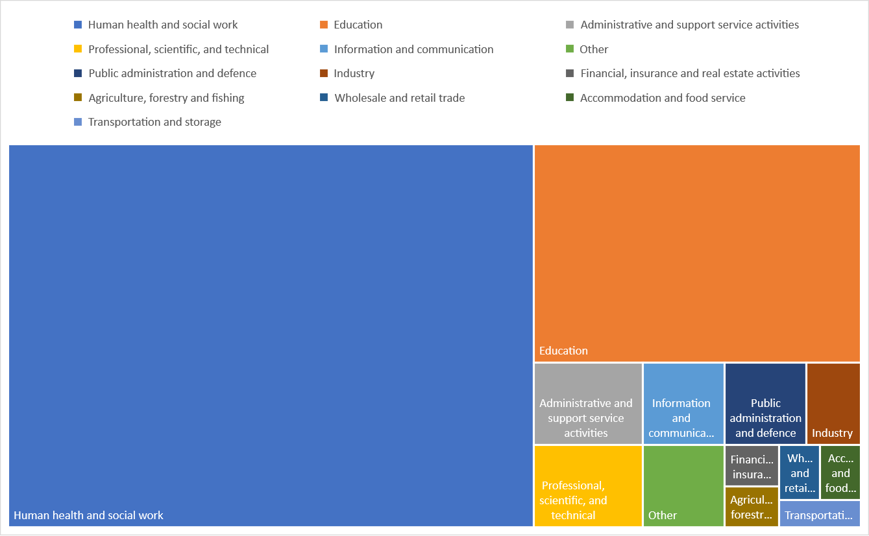
All PGs
Notes:
Data from 183 previous students that graduated in the years 2017 to 2021 regarding their current sector of employment was analyzed. 79% of the respondents were identified as female, the remaining 21% were male. Most data were obtained from postgraduates (n = 146, 120 female) compared to undergraduates (n = 37, 25 female).

Slide 21
Female PGs
Notes:
Data from 183 previous students that graduated in the years 2017 to 2021 regarding their current sector of employment was analyzed. 79% of the respondents were identified as female, the remaining 21% were male. Most data were obtained from postgraduates (n = 146, 120 female) compared to undergraduates (n = 37, 25 female).

Slide 22
Male PGs
Notes:
Data from 183 previous students that graduated in the years 2017 to 2021 regarding their current sector of employment was analyzed. 79% of the respondents were identified as female, the remaining 21% were male. Most data were obtained from postgraduates (n = 146, 120 female) compared to undergraduates (n = 37, 25 female).

Slide 23
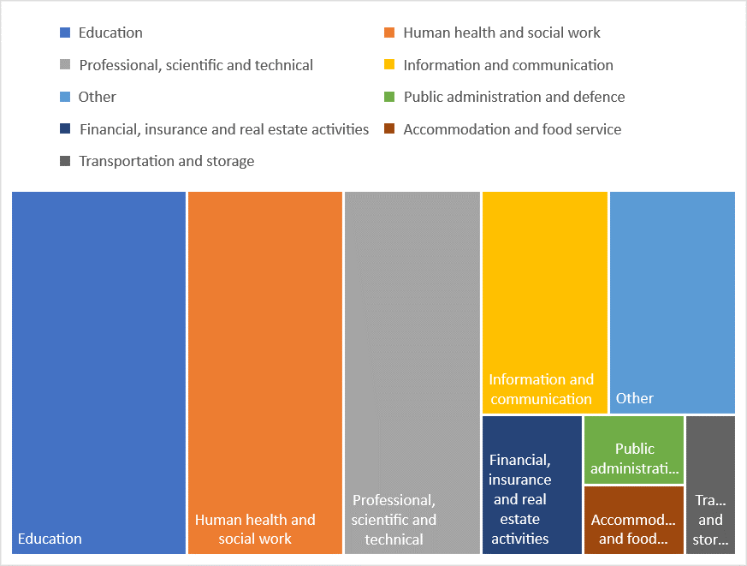
All UGs
Notes:
Note that the legend colours change here!
Data from 183 previous students that graduated in the years 2017 to 2021 regarding their current sector of employment was analyzed. 79% of the respondents were identified as female, the remaining 21% were male. Most data were obtained from postgraduates (n = 146, 120 female) compared to undergraduates (n = 37, 25 female).

Slide 24
What do you think are the biggest / most important EDI activities and actions? That is, what should we be focused on, in terms of:
School culture
Staff recruitment, development, and progression
Student recruitment and support
Governance, policies, and data
Communications and marketing

