Slide 1
Equality, Diversity, and Inclusion
Update – March 2023

Slide 2
What is EDI?
“We are committed to creating an inclusive, diverse, and pluralist College community and a positive environment in which all can participate, and all are recognised fully for their contributions. We are committed on all equality grounds to protecting staff and students from discrimination and to ensuring that diversity is promoted and celebrated.”

Slide 3
Who are we?
20 members, including students and staff
Five working groups
Culture (Lead: Adele Grazi)
Staff recruitment, development, and progression (Redmond O’Connell)
Student recruitment and support (Lorraine Swords)
Governance, policies, and data (Clare Kelly & Kristin Hadfield)
Communications and marketing (Michael Gormley)

Slide 4
What are our priorities?
Athena Swan (2020) → 60 actions
Equal opportunities in career progression
Work-life balance
Building an inclusive culture
Wellbeing and mental health
Anti-harassment and bullying
Support for staff and students with disabilities
Meetings during core hours (10am-4pm)
(among others)
Athena Swan 2024!

Slide 5
What have we accomplished in the past year?
Funding from Trinity Inc to conduct research on factors affecting applications to post-grad courses by gender (Lori, Fiona)
Promotions event + pushing for more staff events and staff-student interaction
Annual review with Head of School → in the coming two months
Data gathering and transparency
Some things are changeable only at College level, but we have worked to promote EDI in these
Promotions update, hiring procedures, progression, etc

Slide 6
State of EDI issues in the School
Conducted survey of students – May 2022
53 respondents
20 undergrad, 13 postgrad masters, 12 PhD, 4 postgrad doctorate,
Conducted survey of staff - February 2023
48 respondents
22 academic, 13 administrative, 6 postdocs, 3 research assistants, 2 technical
Data from HR and College EDI

Slide 7
Student survey
72% straight/heterosexual, 12% bisexual, 4% gay/lesbian, 4% asexual + 8% prefer not to answer (PNTA)
74% female, 18% male, 4% non-binary + 4% PNTA
4% have different gender identity from assigned at birth
18% minority ethnic background
14% with caring responsibilities

Slide 8
Student survey
“The prevailing culture and atmosphere in the SoP is inclusive and friendly to all” → 16.7% strongly agree, 60.4% agree, 18.8% neither agree nor disagree, 4.2% disagree
Male students feel marginalised → “It feels cynical to refer to myself as the "majority"(white/man/straight) when I know I am one of the few men doing a PhD in my field. it also feels especially bad to see positions or awards advertised to women, when I am (men are) the minority at my level/position”
With the cost-of-living crisis, students need dedicated space to store/heat food and eat → “You need more facilities where students can access kitchenettes or even just hot water.”
Some students feel they are treated inequitably based on their background → “unless you are a first class student or affluent then the department doesn’t want to know”
Lecturers and staff are supportive → “always been supportive and very helpful”

Slide 9
Student survey
Teaching about gender and engagement with gender issues
“Doesn’t happen” / “never really discussed it” to “This is done well”
Desire for us to go beyond the gender binary in examples and discussions
Teaching about race and ethnicity
“Doesn’t happen” to “We hardly talked about this topic” to “Felt this was just compulsory lip service” to “This is done well”
Desire for research which focuses outside of WEIRD countries
Presence of diverse role models
Desire for more diversity in terms of socioeconomic, racial, ethnic, etc backgrounds

Slide 10
Staff survey
78.9% straight/heterosexual, 10.5% bisexual, 5.3% gay/lesbian, 5.3% other
62.5% female, 37.5% male, none other genders nor with trans history
2.5% minority ethnic background
51.2% with caring responsibilities
42.9% on permanent contract, 28.6% on CID., 14.3% fixed term, and 14.3% specific purpose

Slide 11
Staff survey
78.9% straight/heterosexual, 10.5% bisexual, 5.3% gay/lesbian, 5.3% other
62.5% female, 37.5% male, none other genders nor with trans history
2.5% minority ethnic background
51.2% with caring responsibilities
42.9% on permanent contract, 28.6% on CID., 14.3% fixed term, and 14.3% specific purpose
78.7% full-time, 21.3% part-time

Slide 12
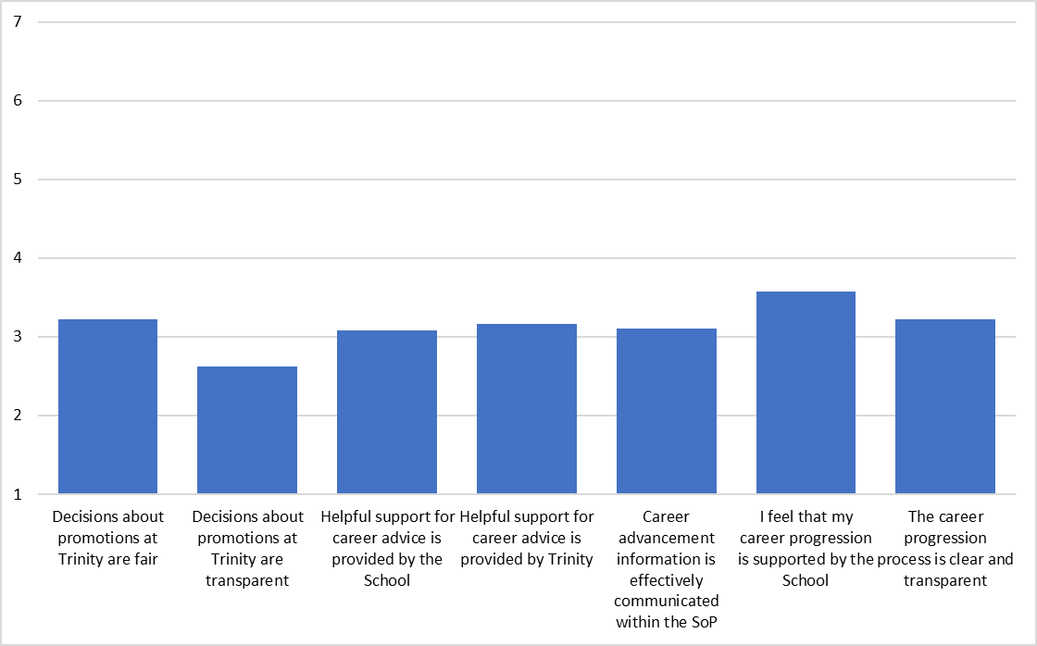
Staff survey
Strongly agree
Somewhat disagree
Strongly disagree
Notes:
There was only one significant difference by job role, with academic staff feeling that decisions about promotion at Trinity were more fair (M=3.76) than administrative staff (M=2.27). There was only one difference by gender, with male staff tending to agree more that the career progression process is clear and transparent (M=4.23) and female staff tending to disagree (M=2.74).

Slide 13
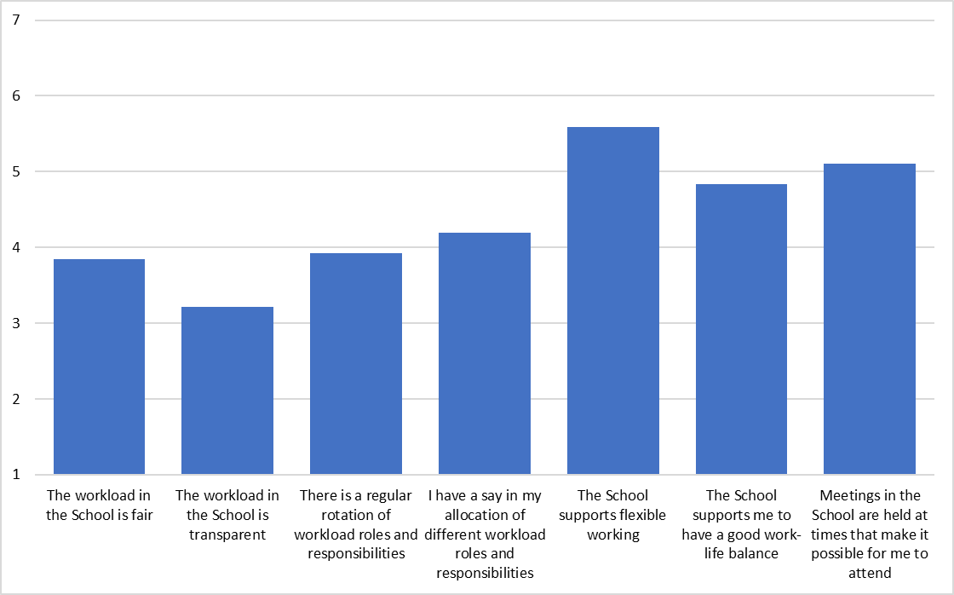
Staff survey
Strongly agree
Somewhat agree
Somewhat disagree
Strongly disagree
Notes:
There were no differences by gender. There were differences by role, with academic staff tending to somewhat disagree that the workload in the SoP is fair (M=3.06) and the admin staff tending to somewhat agree that it is fair (M=4.91). Similarly, the academic staff tended to disagree that the workload in the SoP is transparent (M=2.24), whereas the administrative staff neither agreed nor disagreed (M=4.00).

Slide 14
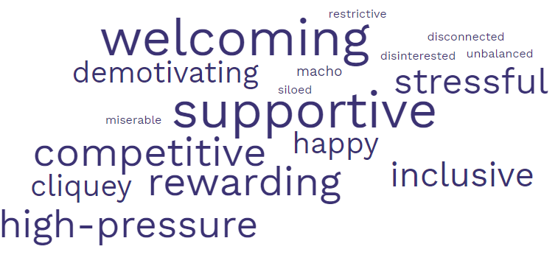
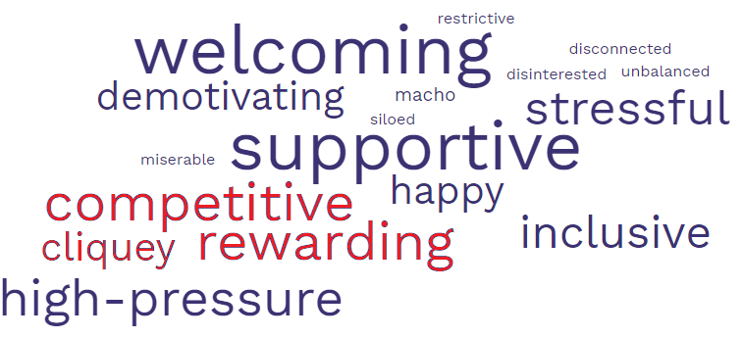
Staff survey
Notes:
Welcoming 19 Supportive 19 Competitive 14 Rewarding 14 High-pressure 13 Stressful 12 Inclusive 11 Happy 9 Cliquey 9 Demotivating 7 Macho 2 Miserable 1 Disinterested 1 Neither good nor bad 1 Restrictive 1 Siloed 1 Disconnected 1 Unbalanced 1 Racist 0 Sexist 0

Slide 15
Teaching tips
He/she → non-inclusive
When providing ‘generic’ examples, don’t just default to male/female, husband/wife, John/Jane, etc
Think about the demographics of the students
If you are unsure of a person’s gender, use they/them, or ask them → don’t just assume based on name
Alt-text for figures in powerpoint etc

