Slide 1
3B8 Universal Design Innovation
Trinity College Dublin Coláiste na Tríonóide, Baile Átha Cliath The University of Dublin
Final Showcase
Group 3: Karl Archbold
Scott Hodgins
Jack McKiernan
Bronagh Quinn

Slide 2
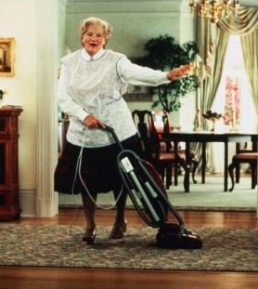
“The mission statement of group 3 is to assist an elderly person vacuum their home with relative ease without much physical effort”

Slide 3
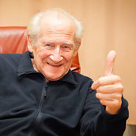
Meet The Stakeholders
Elderly Women
Elderly Men
Professionals
Students
Retired Accountant- 68
Housewife (x4)- 73, 79, 82, 84
Retired Nurse- 85
Retired Carer- 77
Cleaner (x2)-70
Retired Factory Worker- 82
Retired Engineer- 75
Groundskeeper- 76
Taxi Driver (x2)- 77, 79 Retired Bar Man- 73
Retired- 80
Retired Mechanic- 76
GP Doctor (x2)
Nurse
Carer
4th year Physio
4th year OT
3rd year nurse (x3)

Slide 4
Needfinding Methods
Online Investigation
Interviews Conducted on Professionals
Surveys Carried out with Stakeholders
Mobility impacted tasks most struggles with at home;
Observation of Participants Research conducted in real setting Participants viewed undertaking task
HOOVERING !!!
Opening Smaller Items
Emptying Bins
Laundry
Emptying Dishwasher
Cooking
12% 6% 23% 12% 35% 12%

Slide 5
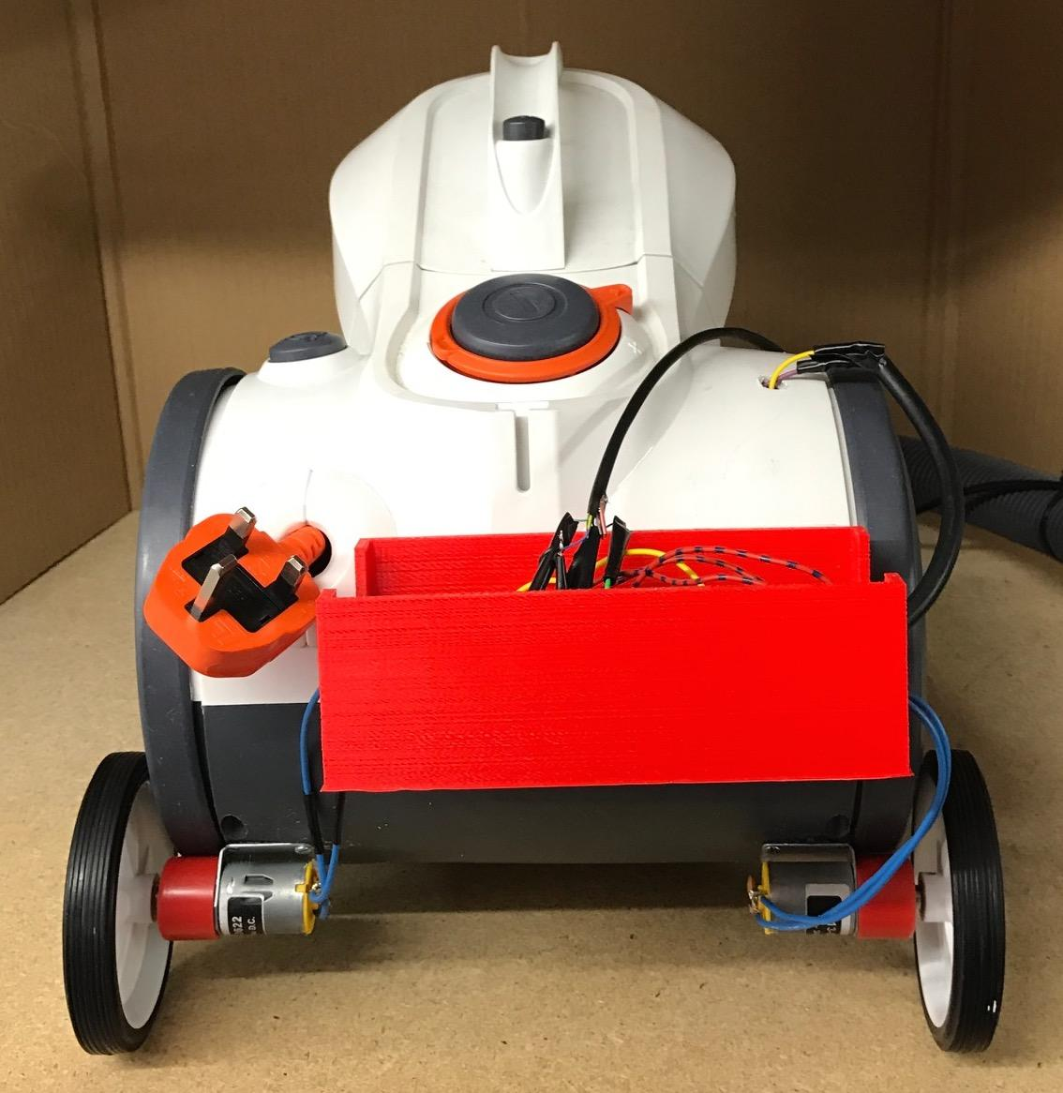
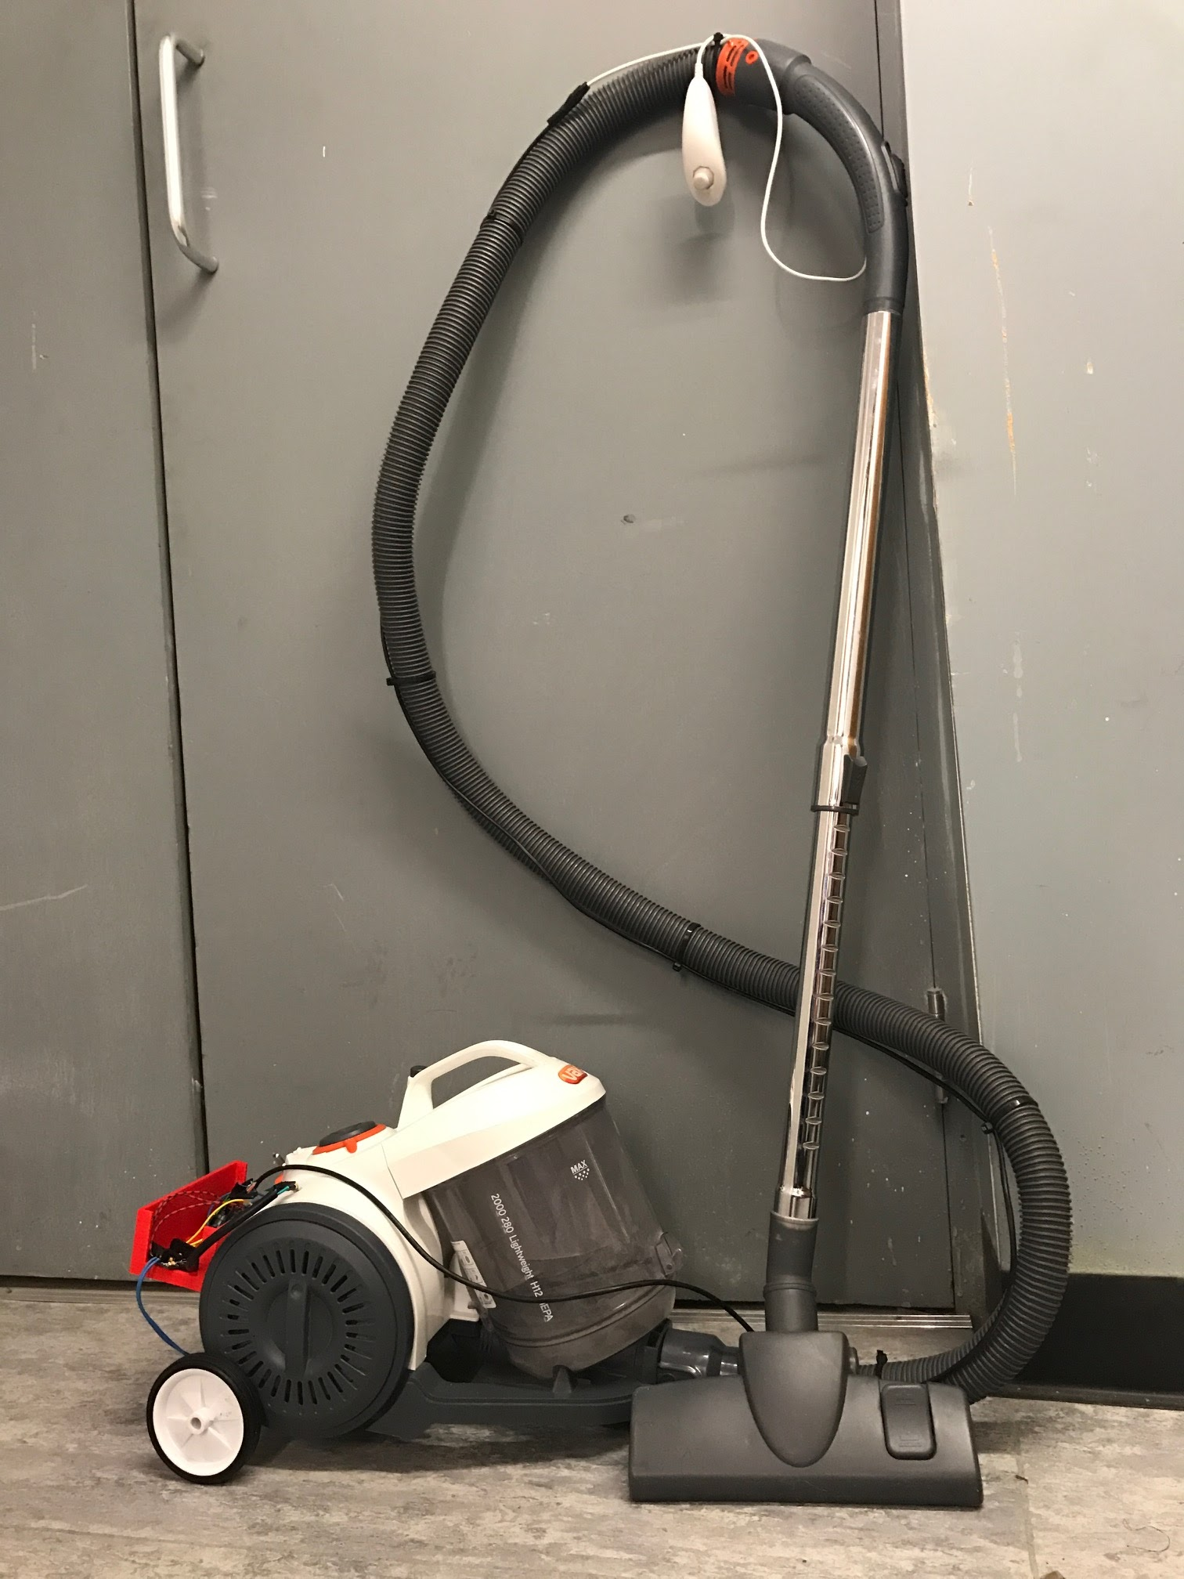
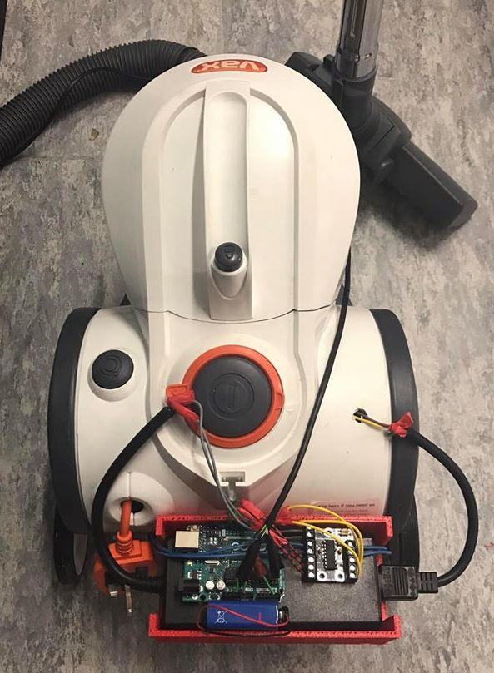
The Noover

Slide 6
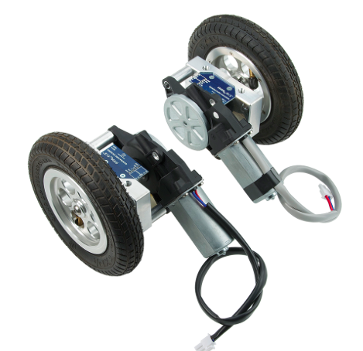
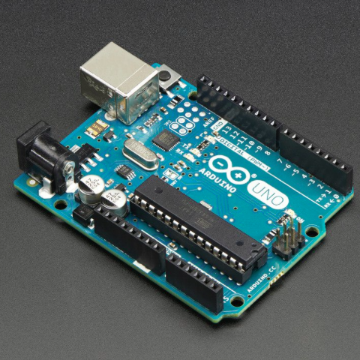
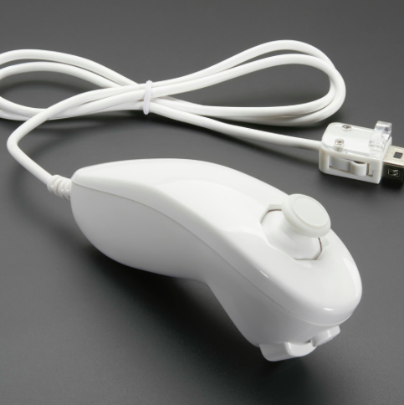
How It Works
Step 3
Step 2
Step 1
Problem: Majority of stakeholders found it difficult to pull the hoover along thicker surfaces (ie. carpet)
Solution: Attaching user controlled motorised wheels to the canister, lessens the physical effort required to trail the vacuum
Signals instruct a shield to drive the motors attached to the wheels accordingly
Signals sent from nunchuck are interpreted by the programmed Arduino Uno
User directs vacuum in desired direction using Wii nunchuck

Slide 7
Why this Design
Canister Hoover
Large dust bag
Powerful (good suction)
Large head covers more surface area
Additional Features
Easy to maneuver
Lessened physical effort required
Easily operated
Inexpensive compared to other mechanically operated vacuums (ie. Roomba)

Slide 8
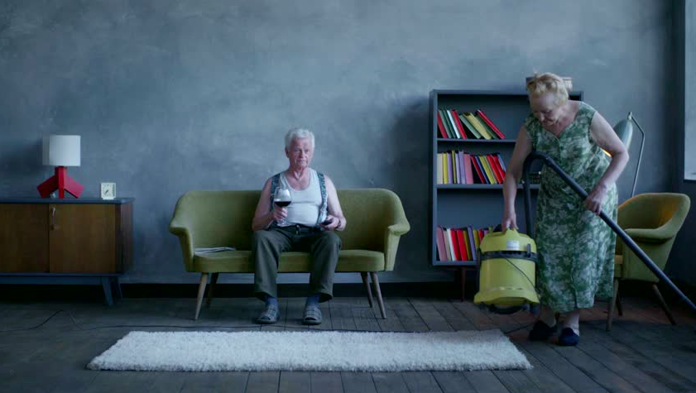
T H A N K Y O U

