Slide 1
3B8 Universal Design Innovation
Group 8
Cillian Heeney
Ian Marron
Conor Morrow
Robyn Moran
Jack Wilson

Slide 2
Group 8
Ian
Conor
Robyn
Cillian
Jack

Slide 3
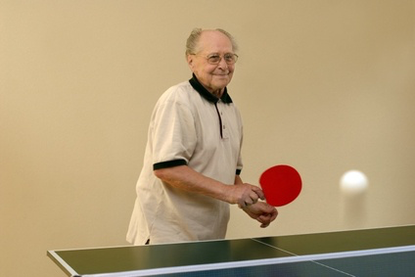
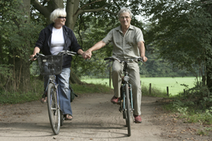
Needfinding
As people get older, simple everyday tasks become more and more challenging.
We conducted research to identify common difficulties faced by the elderly every day.
This research included:
Surveys with elderly relatives, care workers and physiotherapists
Observation of elderly relatives going about daily activities
Face to face interviews

Slide 4
Our Mission
Arthritis affects over 915,000 people in Ireland. It is the single biggest cause of disability.
Symptoms like pain, fatigue and joint inflammation make movement around the house more challenging, particularly for the elderly.
Falling is a leading health concern for over 60s. Muscle degeneration inhibits movement and increases the risk of injury.
To facilitate safe and secure movement throughout the home, allowing the user to stay as mobile as possible, enabling continued household activity.

Slide 5
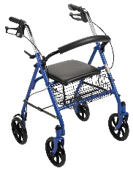
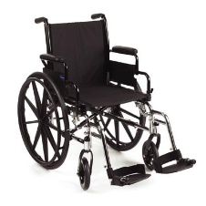
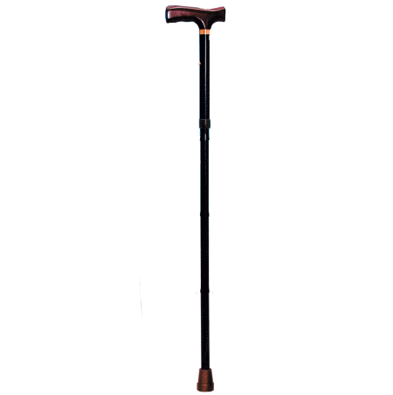
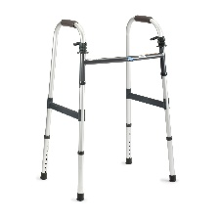
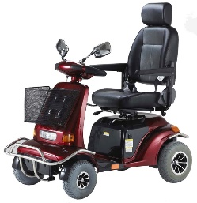
Our Solution
Strategy
Adapt current walking aids to facilitate mobility in the home, with emphasis on reducing the risk and effects of falling.
Why?
Current walking aid designs place strain on the lower back and shoulders by requiring the user to lift them as they move.
Walking aids are not suitable for movement in tight spaces such as those found in houses.
Common problems faced by the elderly (eg. falling, arthritis, impaired vision) cause difficulty when using mobility aids.

Slide 6
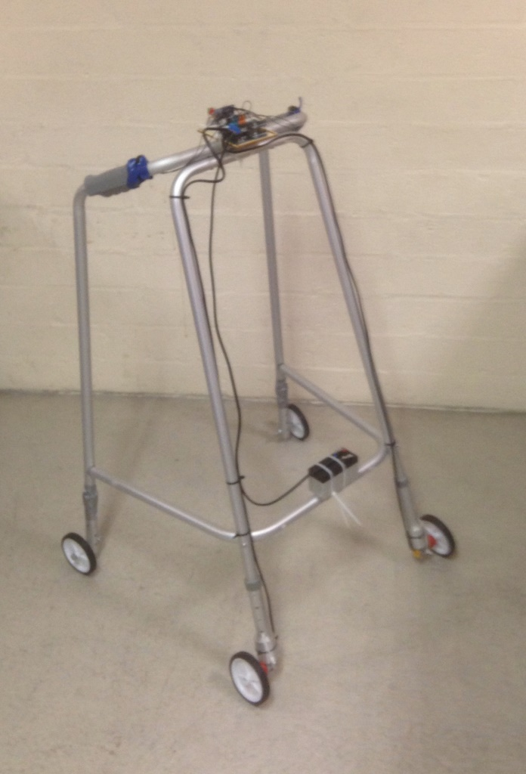
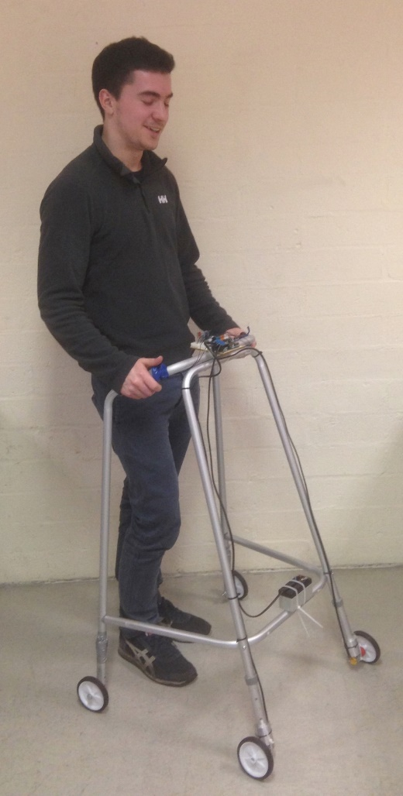
Design
Zimsteer is a modifaction on the current zimmer frame design.
The frame can be steered using simple button controls on handles.
Wheels are motorised and match the user’s walking pace using ultrasonics.

Slide 7
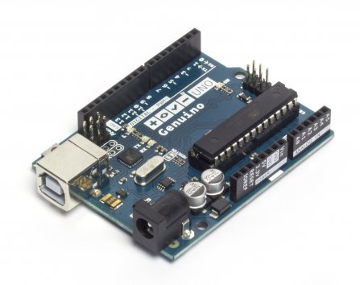
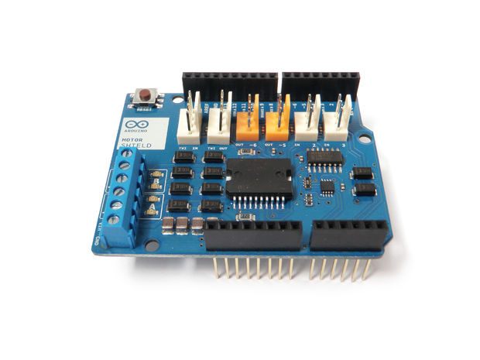
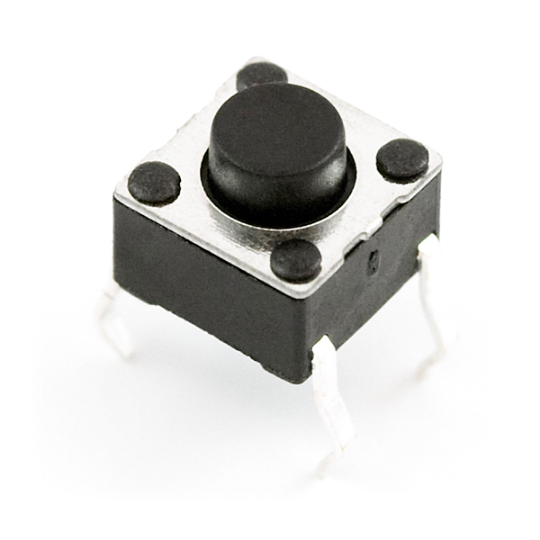
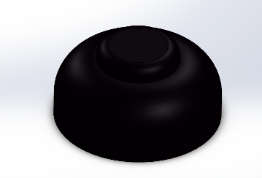
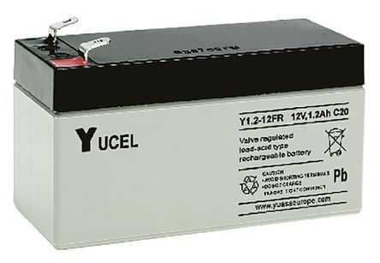
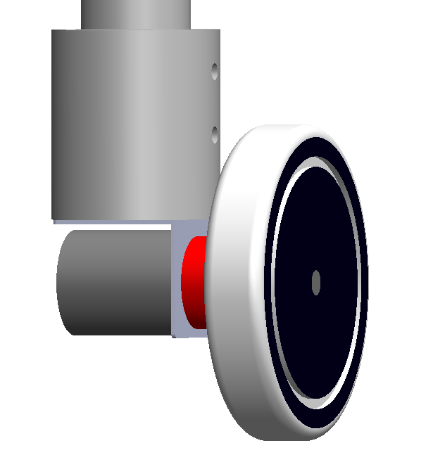
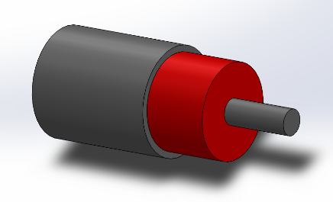
Design
Arduino Uno
R3 Motor Shield
On/off
switch
Push button
control
12V battery
Bracket
Motor

Slide 8
Assembly
Front
Side
Plan
Video – Exploded View

Slide 10
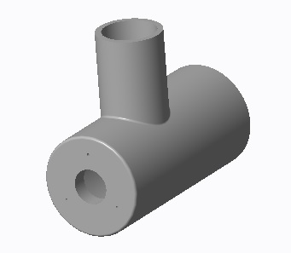
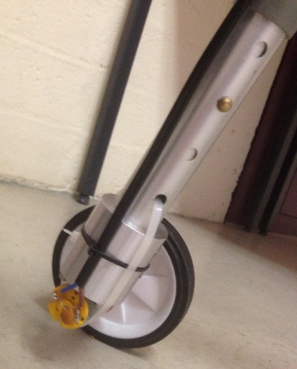
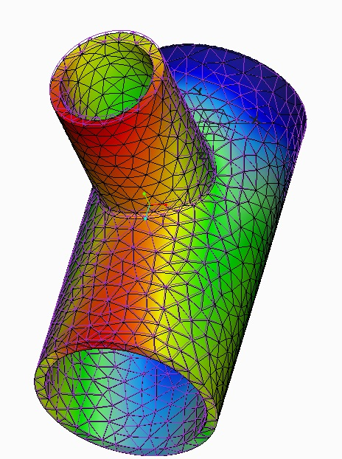
Finite Element Analysis
We designed a bracket to connect the motorised wheels to the legs of the frame.
The Creo Simulate program was used to model the stress distribution and deformation in the part under the load from a user.
A number of modifications were tested to find the best stiffness-to-weight ratio.

Slide 11
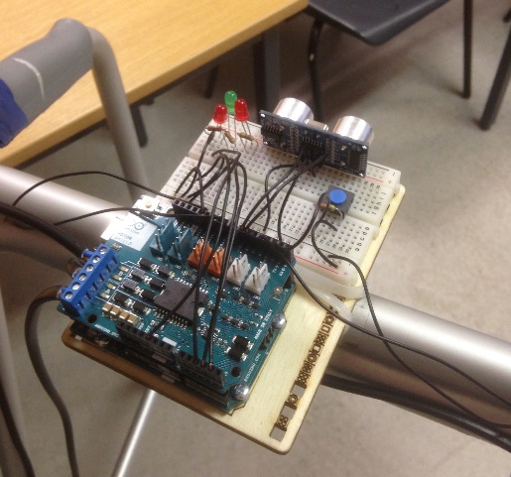
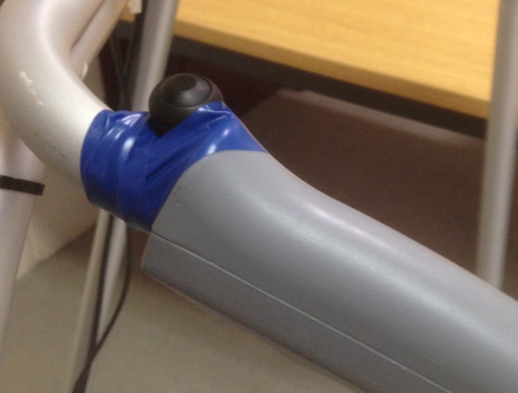
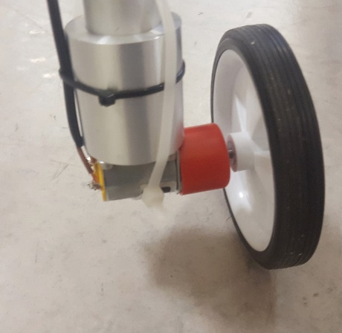
How Zimsteer Works
Arduino Uno
Microcontroller processes input signals.
Controls external components such as LEDs and outputs to motor shield.
Fitted with ultrasonic detector which sets walking pace based on user distance.
R3 Motor Shield
Allows full control of motor direction, speed and braking through integrated H-Bridge, based on signals received from Arduino.
Push Button Switches
Switch located on each handle.
Sends signal to Arduino to engage override.
Large and easy to press for user comfort.
Motor and Bracket
2 directional motor for forward and reverse motion.
Bracket designed to join the motor and wheel to the leg.
One motor runs while the other uses active braking to turn.

Slide 12
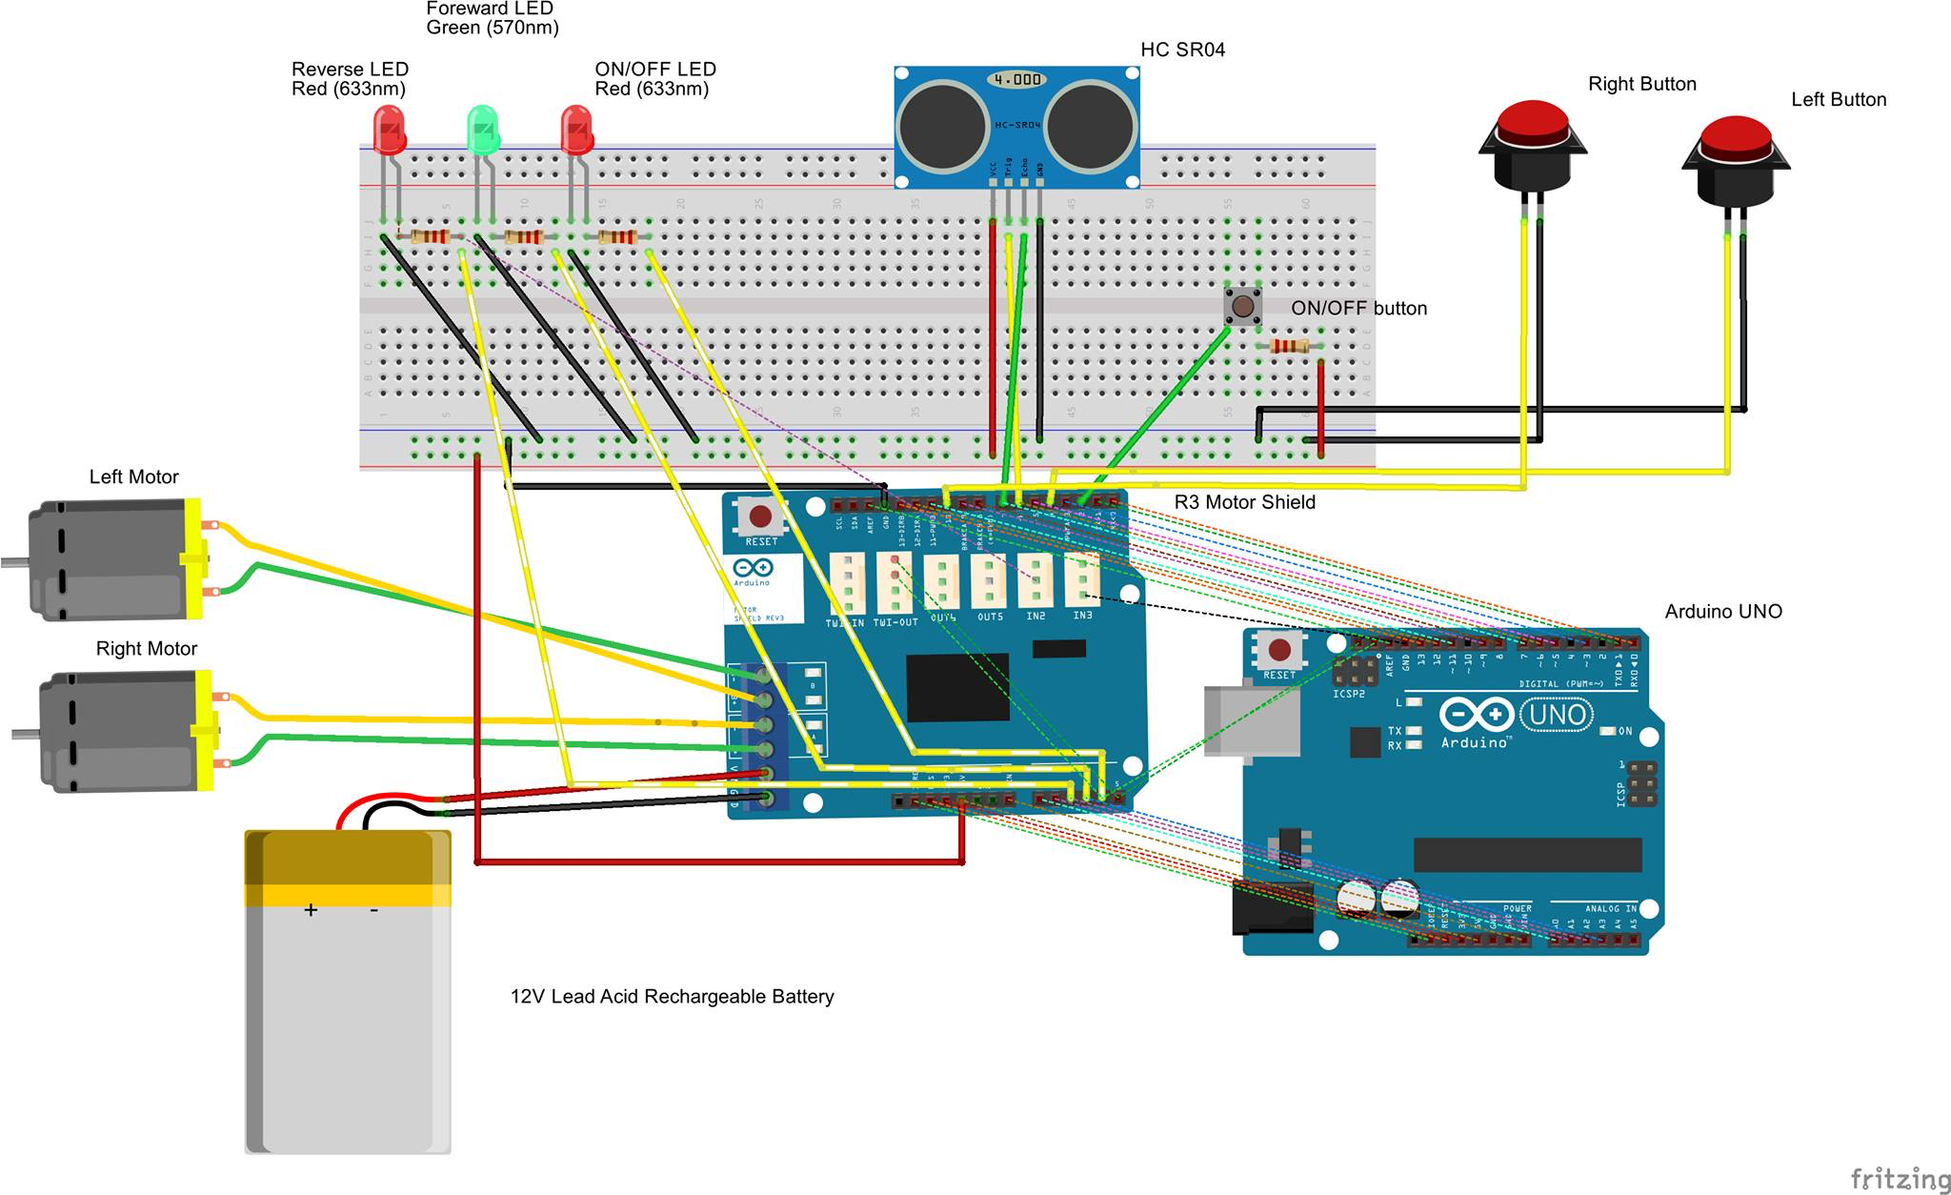
Project Schematic

Slide 13
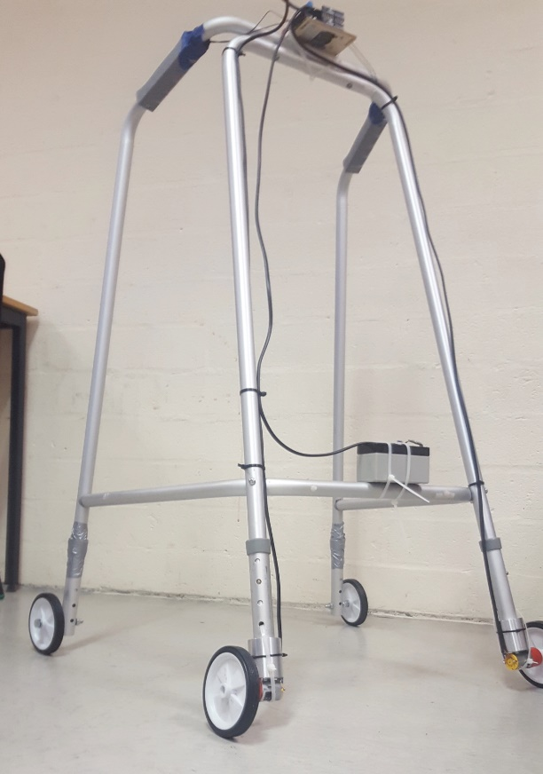
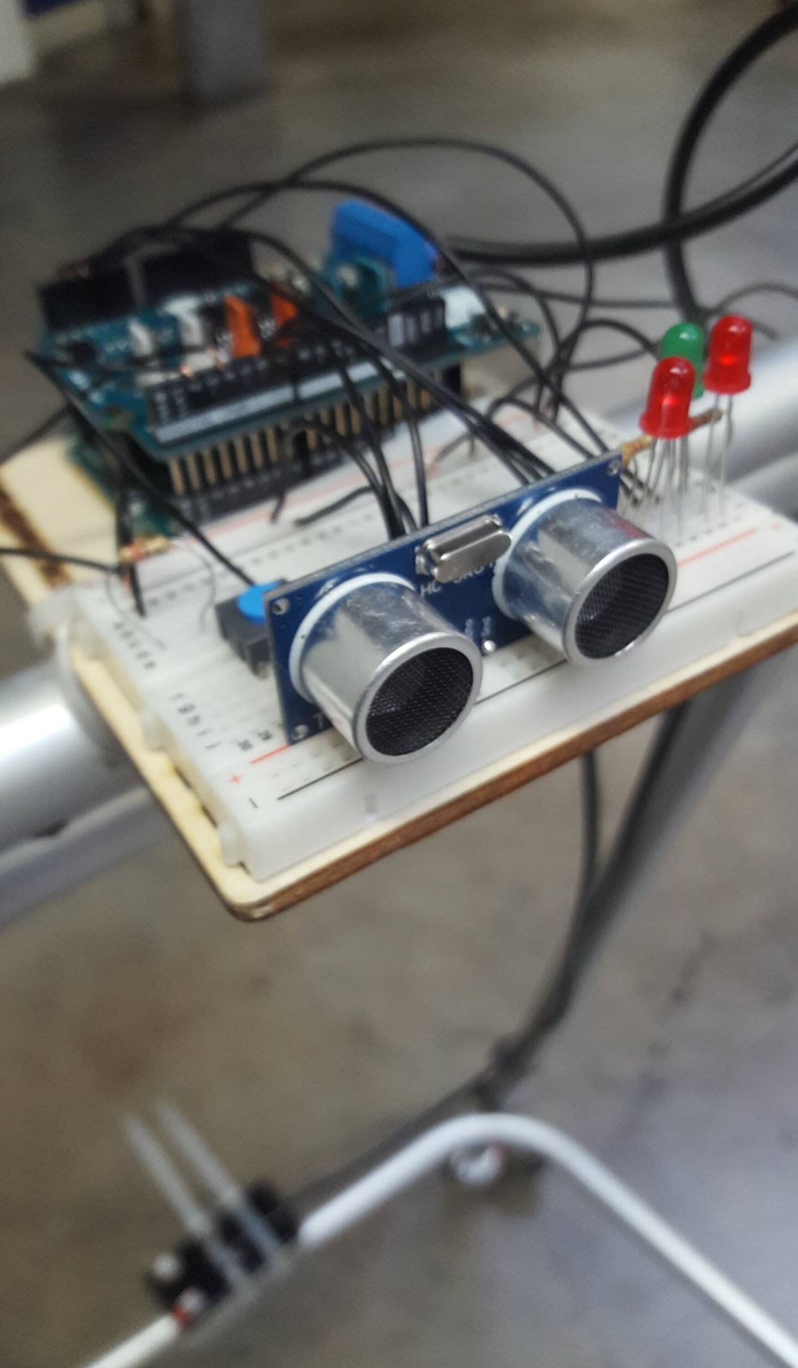
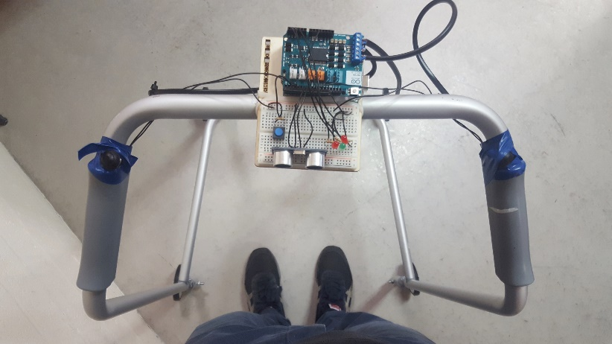
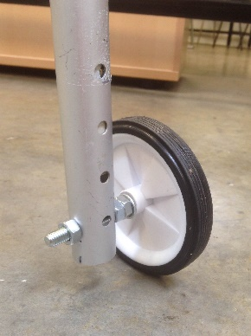
Benefits of Zimsteer
What sets Zimsteer apart from current walking frames?
Increased comfort and maneuverability in tight spaces thanks to motorised steering and light weight.
Reduces strain on shoulders and back as there is no need to lift frame.
There are currently no products on the market with controllable, motorised steering.
Rechargeable battery and intuitive controls.

