Slide 1
Showcase
Group 3
Jack, Colm, Phil, Andrew, Neil
Notes:
http://www.designmantic.com/logo-design/samples?page=8&cat=21

Slide 2
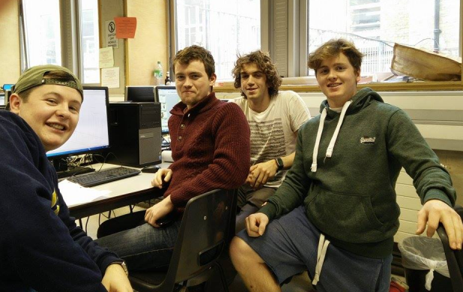
The ZuperFrame
The walking frame that helps the user to sit and stand through fully adjustable height
Notes:
http://www.effectiveservices.org/images/uploads/TCD-logo-wide_2.jpg
https://www.google.ie/url?sa=i&rct=j&q=&esrc=s&source=images&cd=&cad=rja&uact=8&ved=0CAcQjRw&url=http%3A%2F%2Fwww.gadgetgirlreviews.com%2F2014_10_01_archive.html&ei=ApPgVI3FIJKp7Aa774H4CQ&bvm=bv.85970519,d.ZGU&psig=AFQjCNE50R8qlNWPe3nb_M1vDc9EJrpENg&ust=1424090229600575

Slide 3
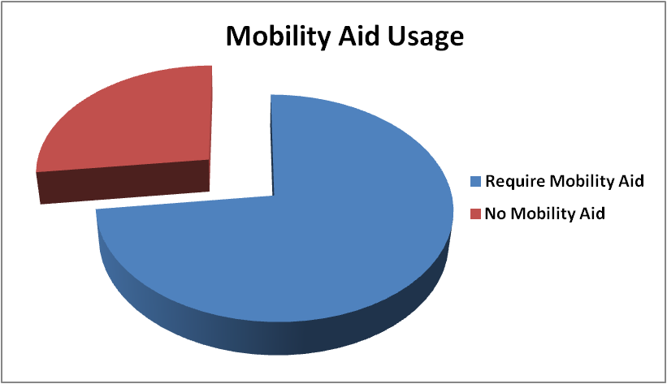
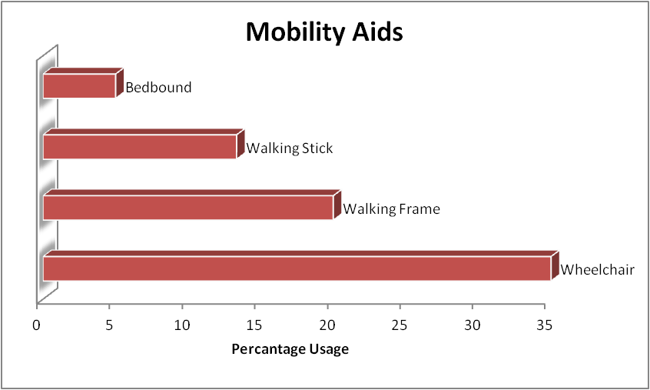
Background
Interviewed and surveyed staff and residents from Friars Lodge and Orwell Health Care
Mobility identified as a major topic
73%
120 Residents
“It would be great if you could do something to stop them falling backwards when they try to sit down using the frame”

Slide 4
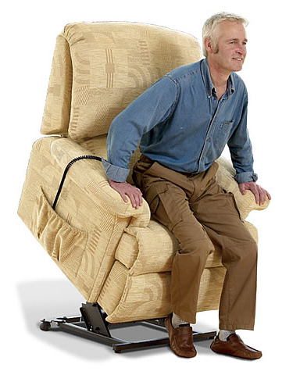
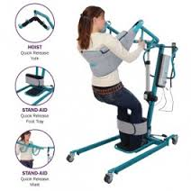
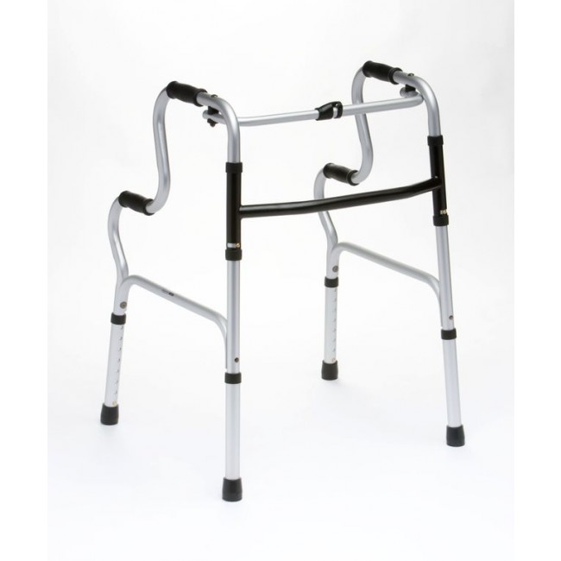
Existing Solutions
Lift & Tilt
Chairs
Gantry
Hoist
Two Level Walking Frame
Prices in excess of 500 Euro
Only for one chair
Prices in excess of 1500 Euro
Not practical for the home
Non-adjustable height

Slide 5
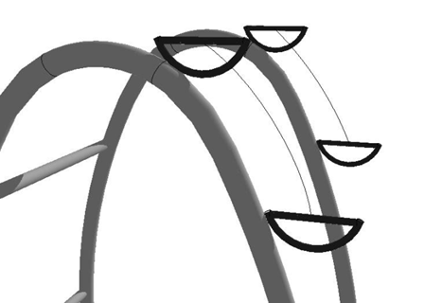
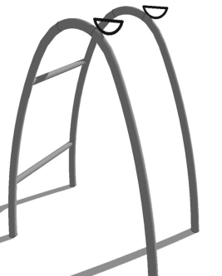
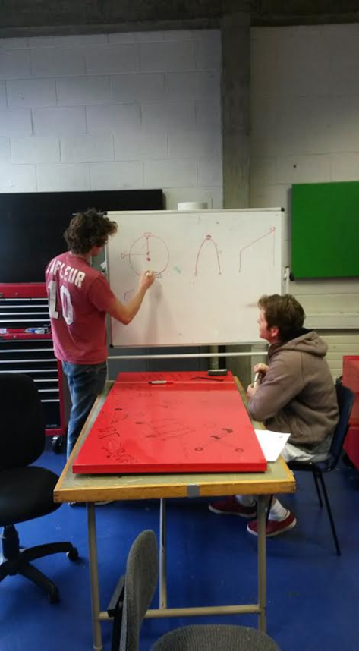
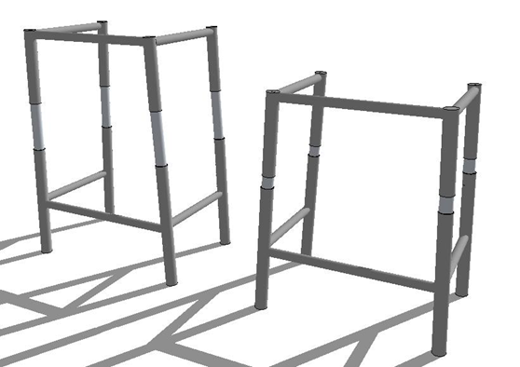
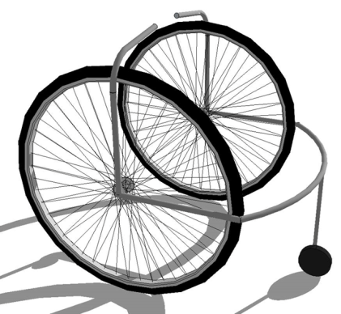
Background
Mission Statement: We want to create a more comprehensive walking aid that helps a user sit and stand without the need of a helper and also promotes activity by making it more appealing
Resistance Band Handles
Piston Frame
Standing Wheelchair

Slide 6
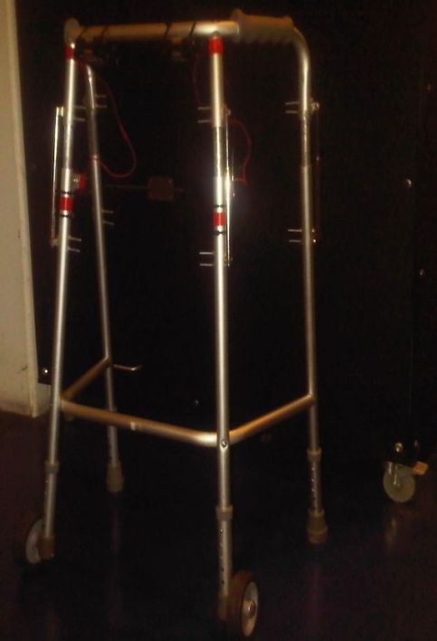
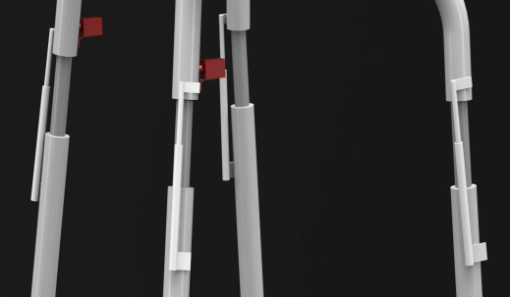
Solution
A walking frame that helps lower the user into sitting position and helps user to stand with ease from sitting through fully adjustable height
User details stored on frame in case of emergency
Different levels of security
General Public
Emergency Services
Name: Mary Wilson
Age: 73
Address: 15 Hanbury Lane D8
N.O.K.: John Wilson 0868684854
Allergies: Aspirin, Peanuts
Blood Type: O –ve
Health Problems: Diabetic

Slide 7
Validation
We went for meeting with:
John Swords Head of procurement for the HBS.
Fannin a large medical supplier
Gerard Flynn head of the department of biomedical engineering in Cork University Hospital.
Notes:
https://www.google.ie/url?sa=i&rct=j&q=&esrc=s&source=images&cd=&cad=rja&uact=8&ved=0CAcQjRw&url=http%3A%2F%2Fen.wikipedia.org%2Fwiki%2FCork_University_Hospital&ei=F5bgVNz8M4OQ7Abx6oCQCg&bvm=bv.85970519,d.ZGU&psig=AFQjCNE7sMOErDCoMrQrhBkasUnt1wMzwA&ust=1424091026593207

Slide 8
ZuperFrame
A walking frame that helps lower the user into sitting position and allows user to stand with ease from sitting through fully adjustable height

