Slide 1

Mini-Showcase
Group 3
Jack, Colm, Phil, Andrew, Neil
Notes:
http://www.designmantic.com/logo-design/samples?page=8&cat=21

Slide 2


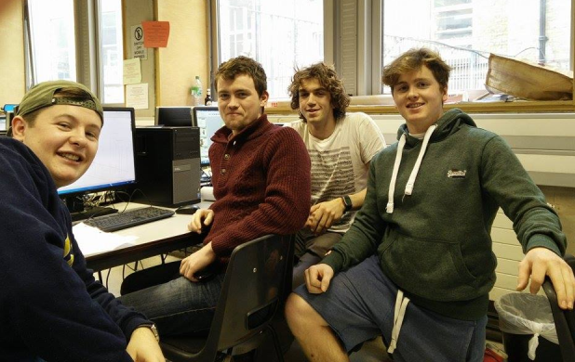

Branding
The Team
Mission Statement:
We want to create a more comprehensive walking aid that helps a user sit and stand without the need of a helper and also promotes activity by making it more appealing
Notes:
http://www.effectiveservices.org/images/uploads/TCD-logo-wide_2.jpg
https://www.google.ie/url?sa=i&rct=j&q=&esrc=s&source=images&cd=&cad=rja&uact=8&ved=0CAcQjRw&url=http%3A%2F%2Fwww.gadgetgirlreviews.com%2F2014_10_01_archive.html&ei=ApPgVI3FIJKp7Aa774H4CQ&bvm=bv.85970519,d.ZGU&psig=AFQjCNE50R8qlNWPe3nb_M1vDc9EJrpENg&ust=1424090229600575

Slide 3
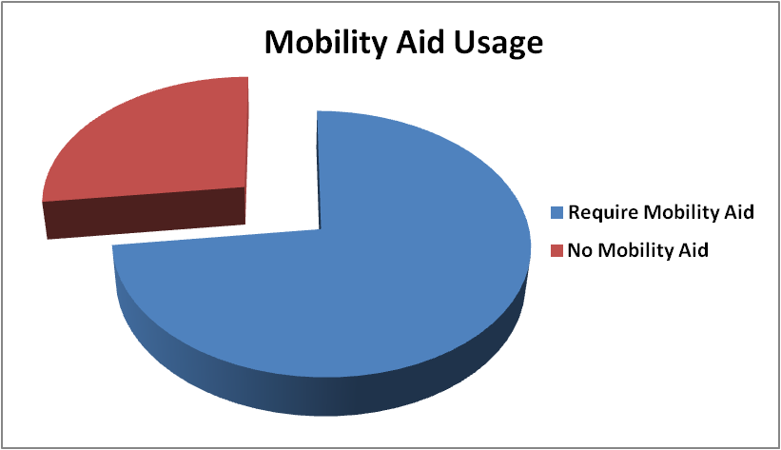
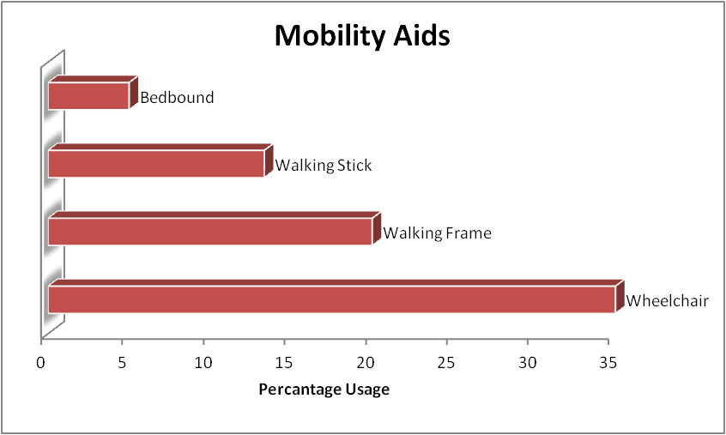

Background
Interviewed and surveyed staff and residents from Friars Lodge and Orwell Health Care
Mobility identified as a major topic
Technical Reports:
  ‘The Economic Cost of Falls and Fractures in People aged 65 and over in Ireland ‘
  ‘Strategy to Prevent Falls and Fractures in Ireland’s Ageing Population’
73%
120 Residents
“It would be great if you could do something to stop them falling backwards when they try to sit down using the frame”

Slide 4
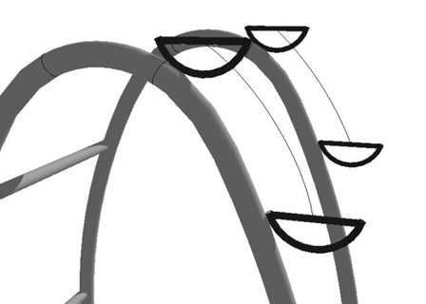
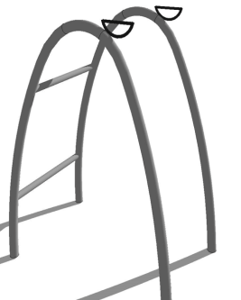
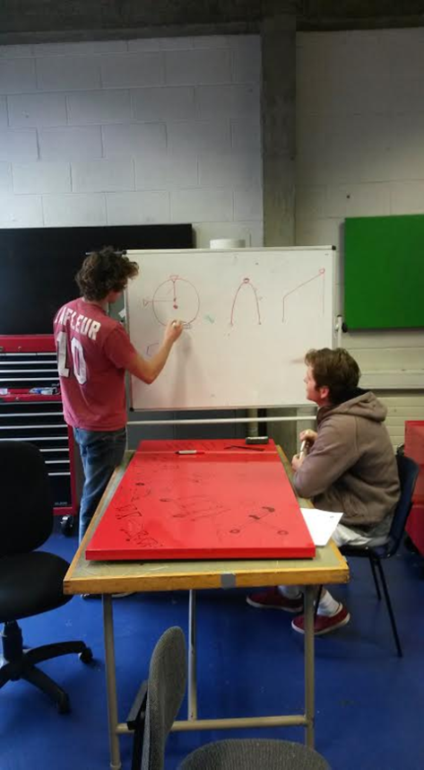
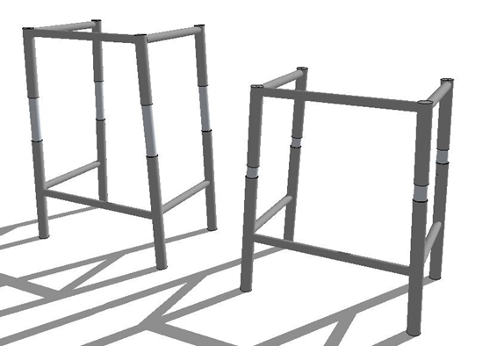
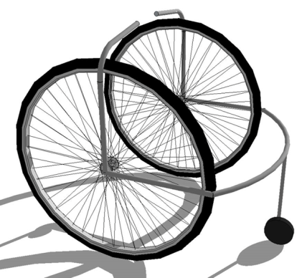
Background
Mission Statement: We want to create a more comprehensive walking aid that helps a user sit and stand without the need of a helper and also promotes activity by making it more appealing
Resistance Band Handles
Piston Frame
Standing Wheelchair

Slide 5

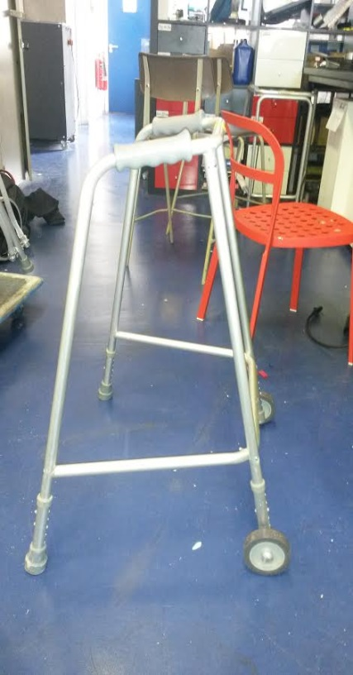
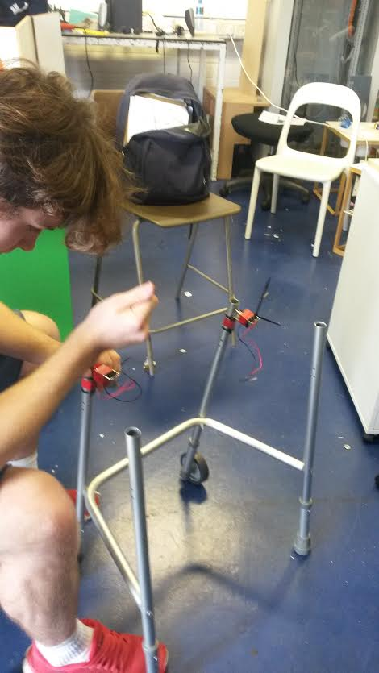
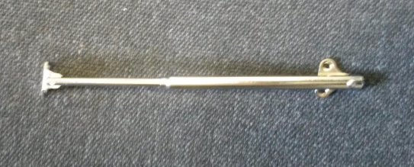

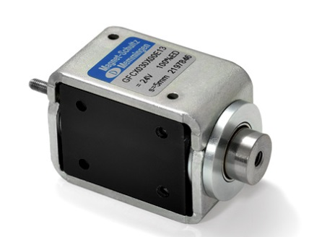
Prototype Production
Major components
Pistons
NFC
Started with HSE standard frame
Solenoids
Frame disassembled, altered and adjusted

Slide 6
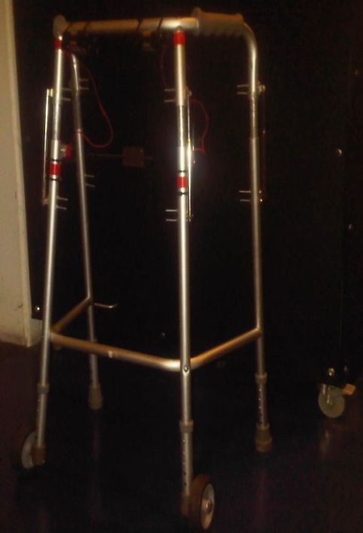
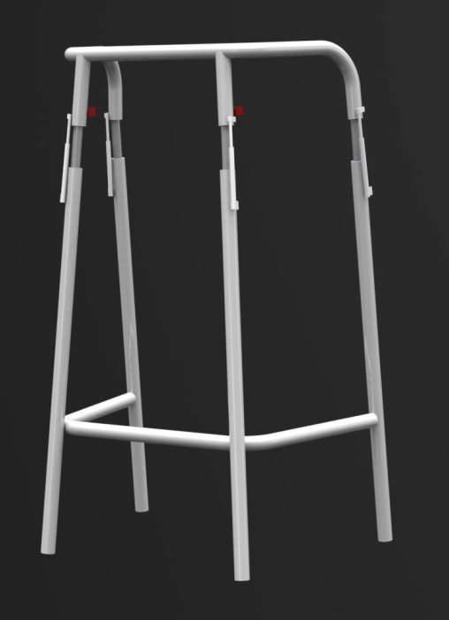
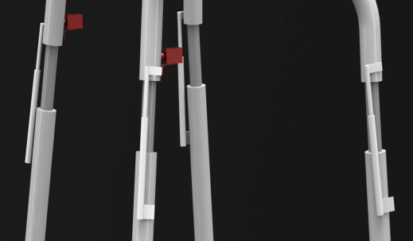

Solution
A walking frame that allows users to sit and stand more easily through fully adjustable height
User details stored on frame
Different levels of security
  General Public
  Emergency Services
Name: Mary Wilson
Age: 73
Address: 15 Hanbury Lane D8
N.O.K.: John Wilson 0868684854
Allergies: Aspirin, Peanuts
Blood Type: O –ve
Health Problems: Diabetic

Slide 7
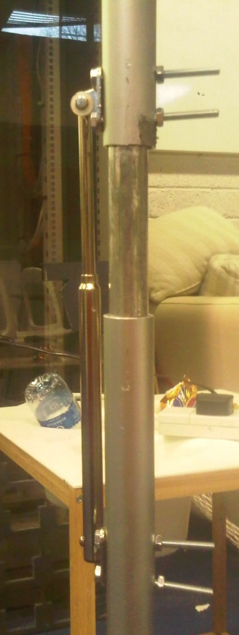
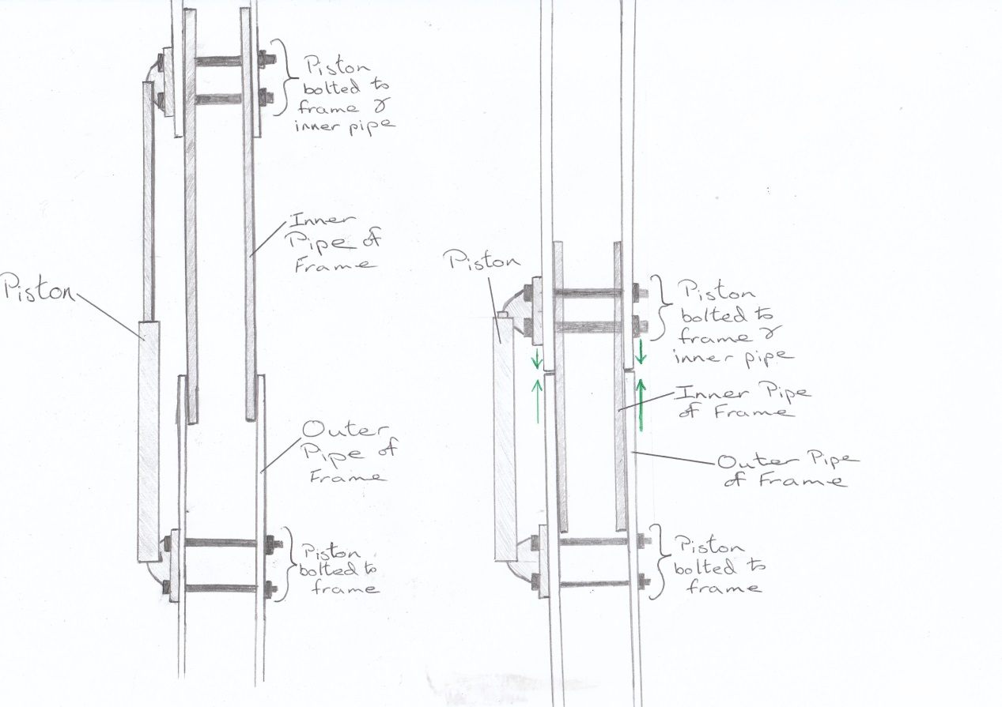
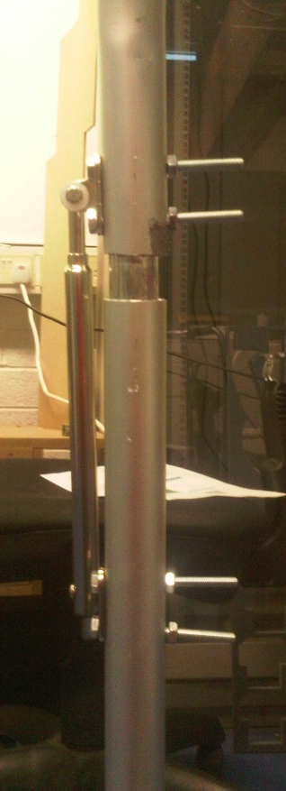
Solution Modules
Raising & Lowering
Mechanism
Full Uncompressed Height
Compressed Height
Pistons attached to each leg of the four legs of the walker

Slide 8
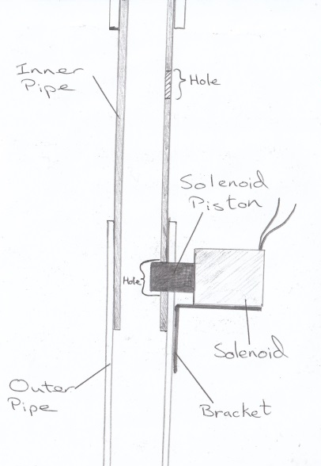
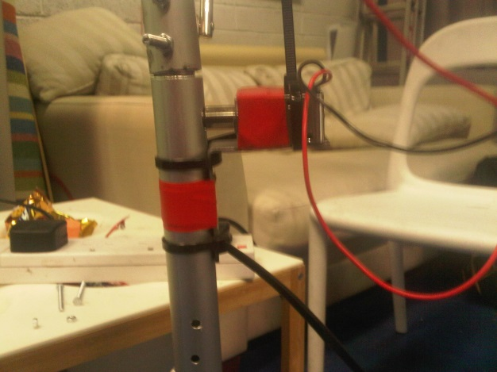
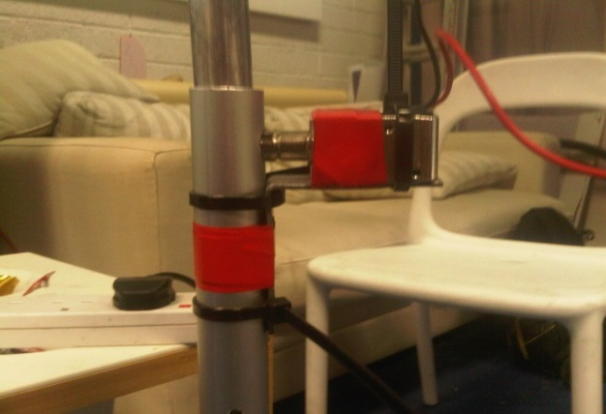
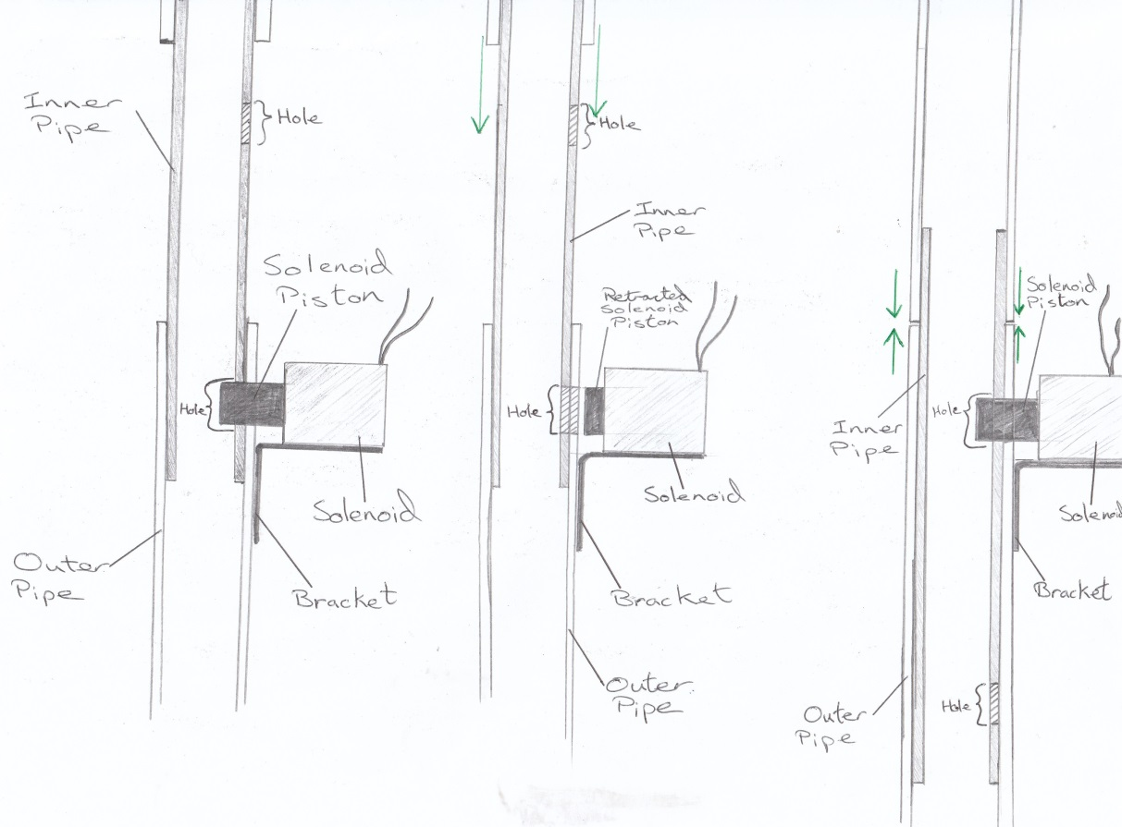
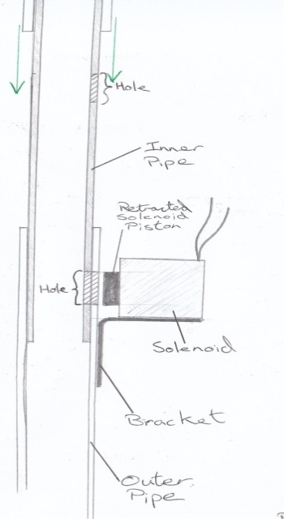
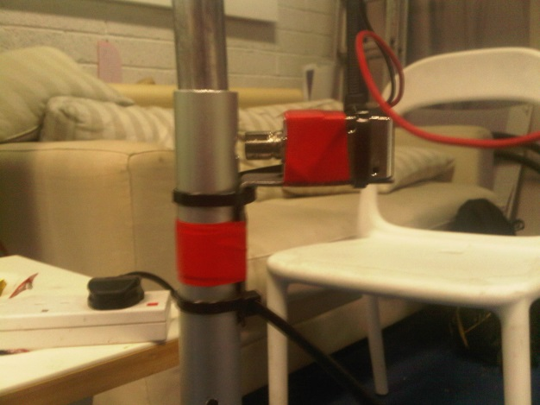
Solution Modules
Locking Mechanism
Full Uncompressed Height
Compressed Height

Slide 9



Validation
We went for meeting with:
John Swords Head of procurement for the HBS.
Fannin a large medical supplier
Gerard Flynn head of the department of biomedical engineering in Cork University Hospital.
Notes:
https://www.google.ie/url?sa=i&rct=j&q=&esrc=s&source=images&cd=&cad=rja&uact=8&ved=0CAcQjRw&url=http%3A%2F%2Fen.wikipedia.org%2Fwiki%2FCork_University_Hospital&ei=F5bgVNz8M4OQ7Abx6oCQCg&bvm=bv.85970519,d.ZGU&psig=AFQjCNE7sMOErDCoMrQrhBkasUnt1wMzwA&ust=1424091026593207

Slide 10

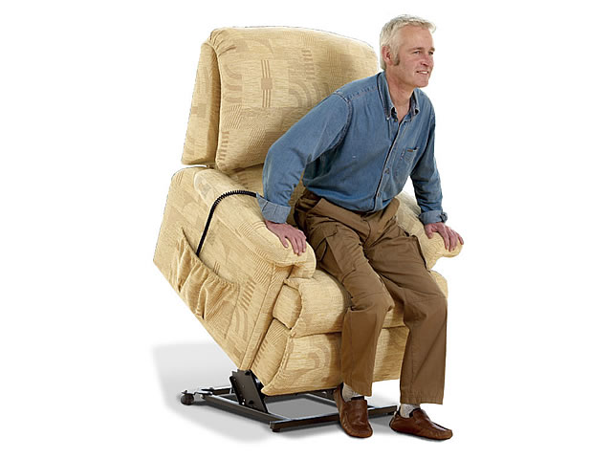
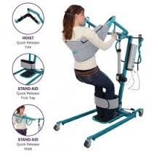
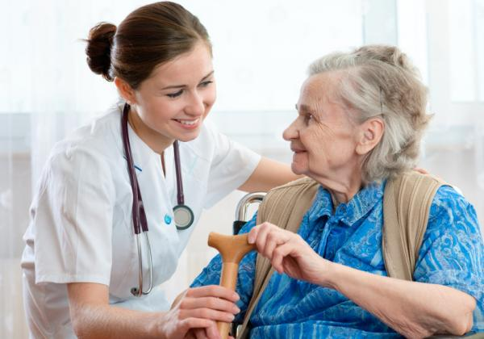
Competitive Analysis
We are offering a low cost solution to the likes of lift recliner chair, hoists or several people aiding you.
Requires round the clock assistance
Prices in excess of 500 Euro.
Hard to use on your own
Our solution costs approximately 45 Euro

Slide 11
Competitive Analysis
“Though more expensive than an ordinary frame” Pat Tracey, Fannin’s
Provides valuable extras
The NFC chip that contains relevant medical information
The pistons to allow people to ascend in and out of their chair
Reduce the amount of falling
Hip replacement 22000 Euro Approximately
2002 4.6 million Euro on fall related hip fractures
Prevention better than cure.
Reduce the number of people been admitted to hospital
Encourages better posture
Notes:
‘22000 Euro’ http://www.paulryan.ie/Why_Consider_Health_Insurance/Default.299.html
‘4.6 million’ ‘The Economic Cost of Falls and Fractures in People aged 65 and over in Ireland ‘

Slide 12
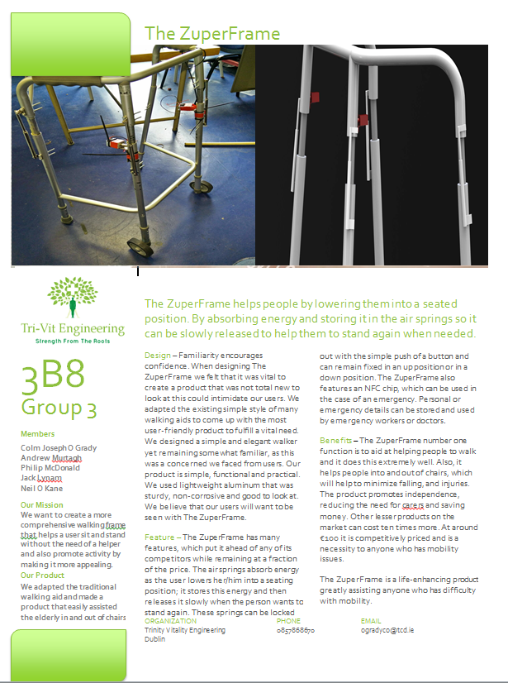
Conclusion

